Slide 1
A presentation will follow, by Paul Gaunt, the author of the book
“Shadows of the Past”
My father, Philip Henry Gaunt ‘Tubby’, a son of Leicester, worked as a salesman in the motor industry, both before and after the Second World War, becoming well known in the Leicester area. To his family he was a hard working provider, but sadly ‘Tubby’ died prematurely, aged 59.
Later, I, also an aviation enthusiast (like my father) began delving into ‘Tubby’s’ wartime service in the RAF Voluntary Reserve and discovering that my father had flown numerous operations sorties as initially a wireless operator/air gunner and later as a pilot.
Eventually ‘Tubby’s’ operational career ended on a Yugoslavian (Croatian) mountainside, when his Wellington bomber crash landed, following icing up, in January 1945. He and his crew were assisted by Tito’s Partisans to escape and evade the Germans. Tubby’ and his crew were repatriated 4 weeks later, after a 160 mile trek over snow covered mountainous terrain.
During my research I visited the crash site, in Croatia, where to my amazement I met witnesses to the crash landing and the Partisan that took the photographs (that you will see in my presentation). It was really nice to find out that record’s and photographs were held and available in local museums.
I am proud to present the story of ‘Tubby' and his air-force colleagues to you.
Also, I would like to thank my brother Terry for his assistance with this presentation.

Slide 2
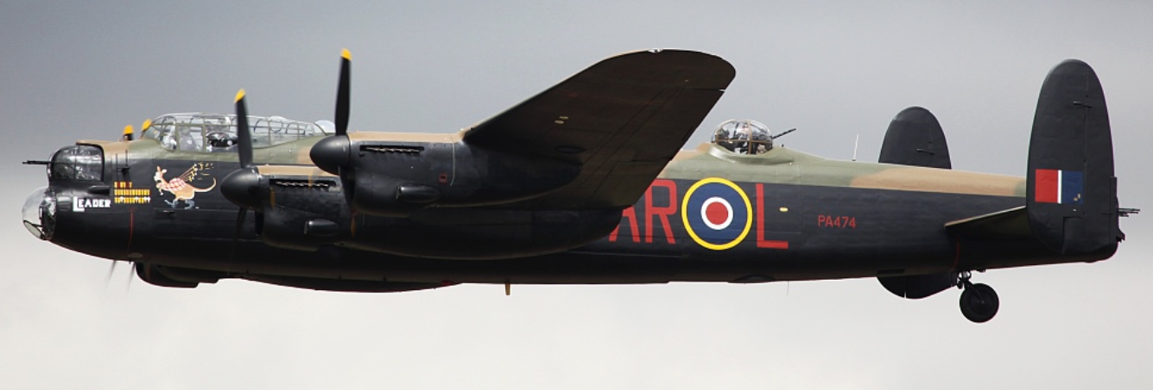
Following a recent incident at Whaley Bridge Dam, Derbyshire Police are keen to interview the pilot of the aircraft below (believed to be from 617 Squadron).

Slide 3
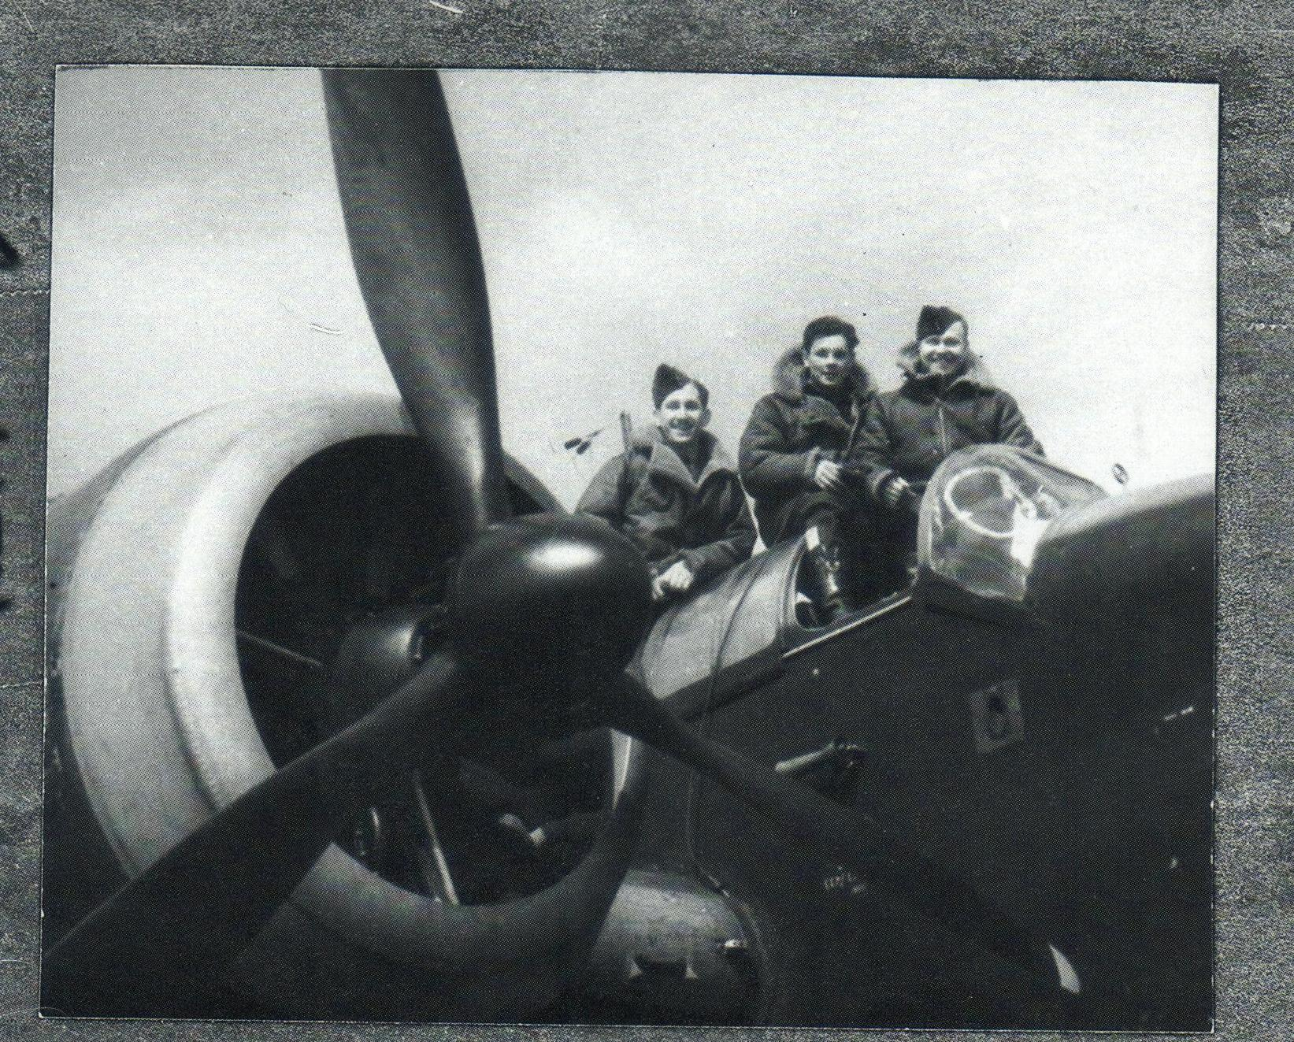

Slide 4
“Shadows of the Past”
A book by PAUL PHILLIP GAUNT
THE STORY OF HIS FATHER PHILIP HENRY GAUNT

Slide 5
15 Years work
“A LABOUR OF LOVE”

Slide 6
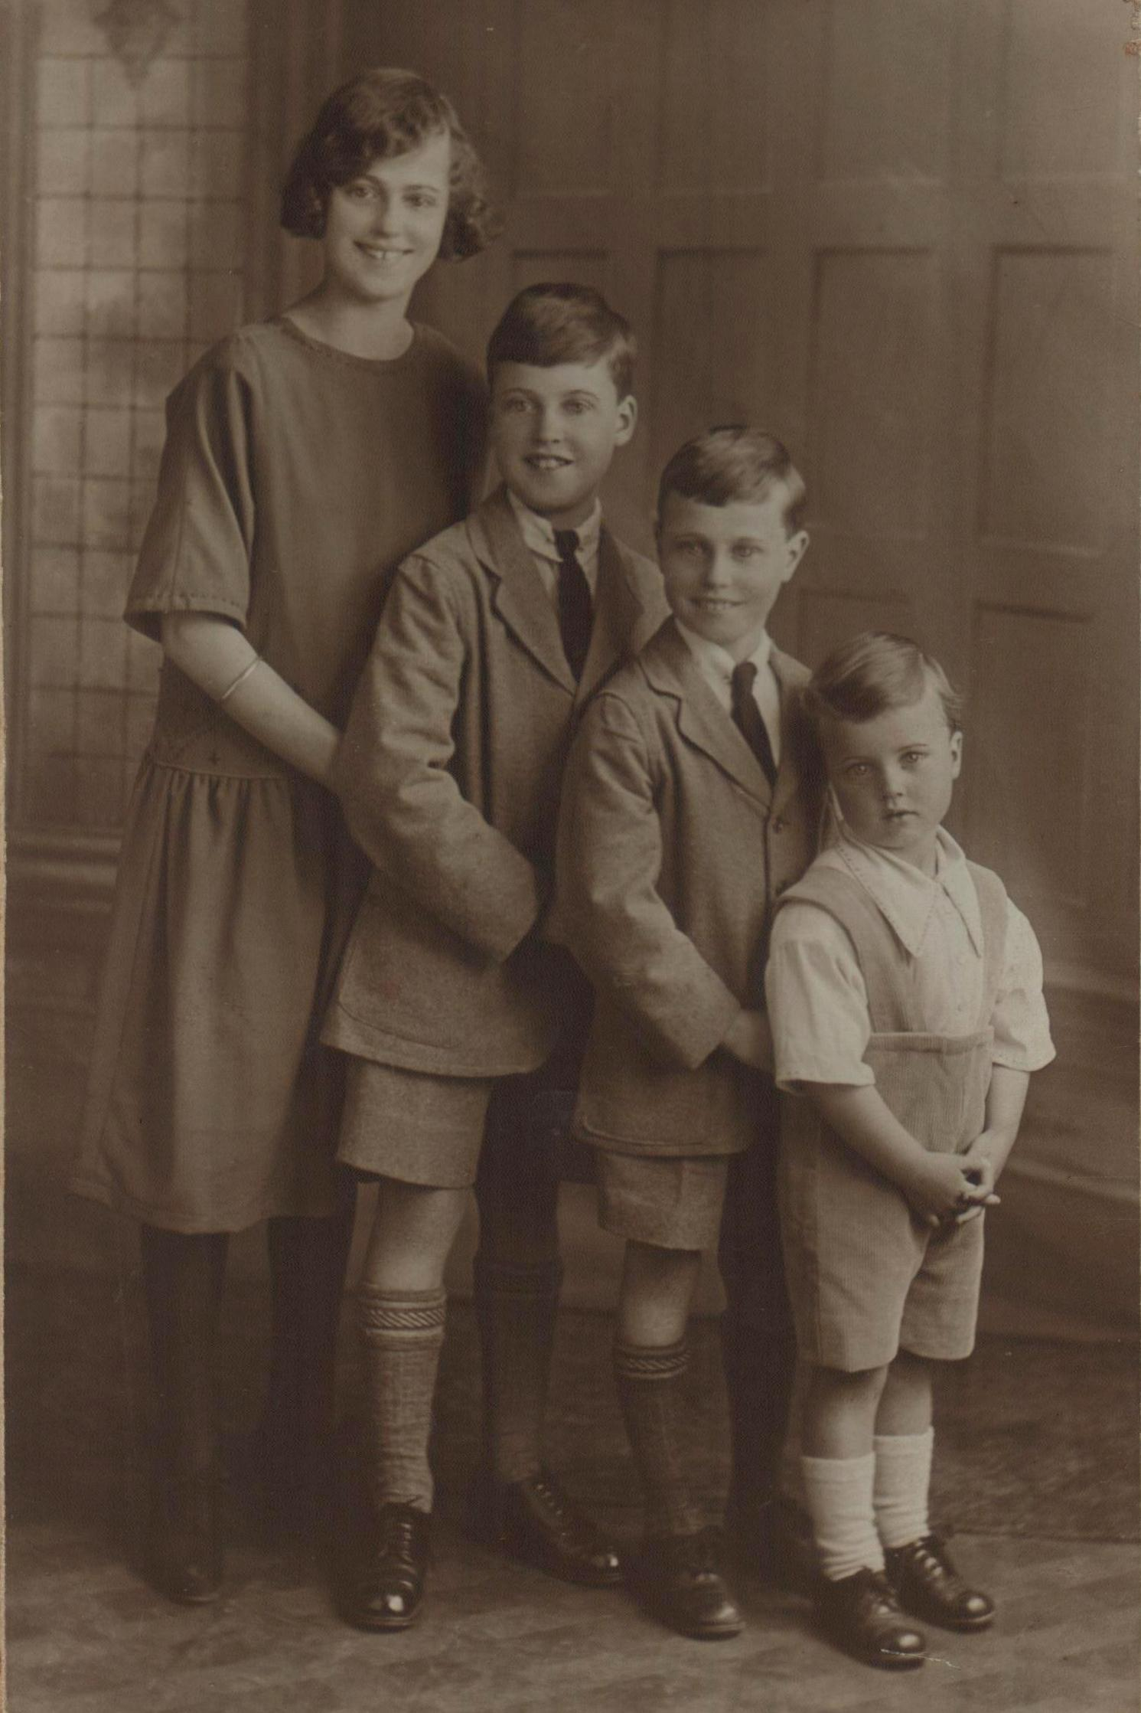
Clarice, Maurice, Philip (Tubby) & Arthur 1926/27

Slide 7
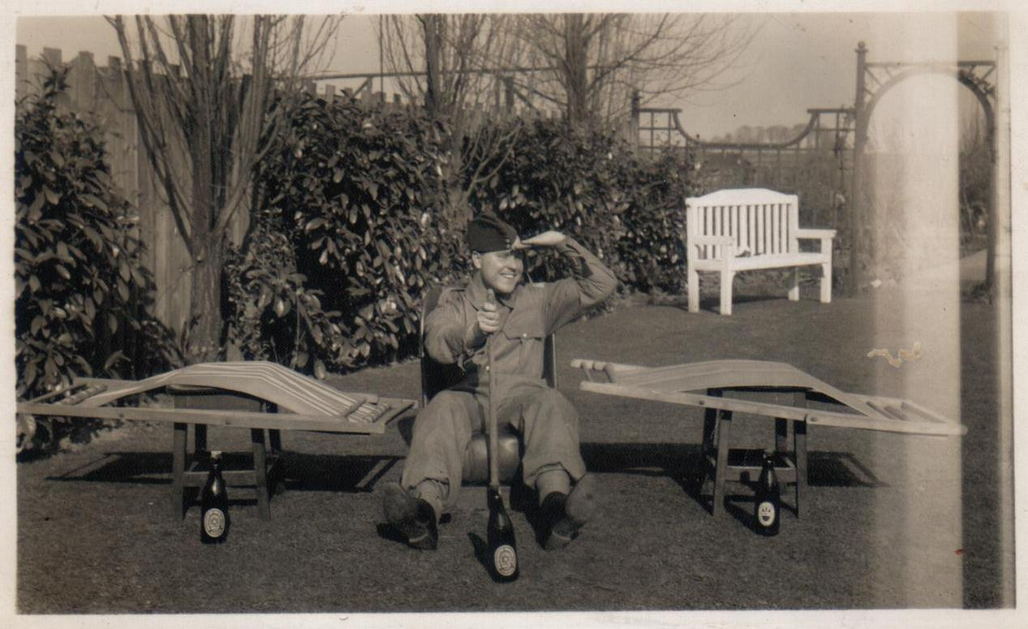
Civil Air Guard
Tubby in Civil Air Guard (CAG) uniform, well on the way towards becoming a pilot, in his father’s garden, Countesthorpe, Leicestershire
Learning to fly was 2/6d (12.5 new pence) per hour. Without the CAG we would not have had enough aircrew on the outset of war.

Slide 8
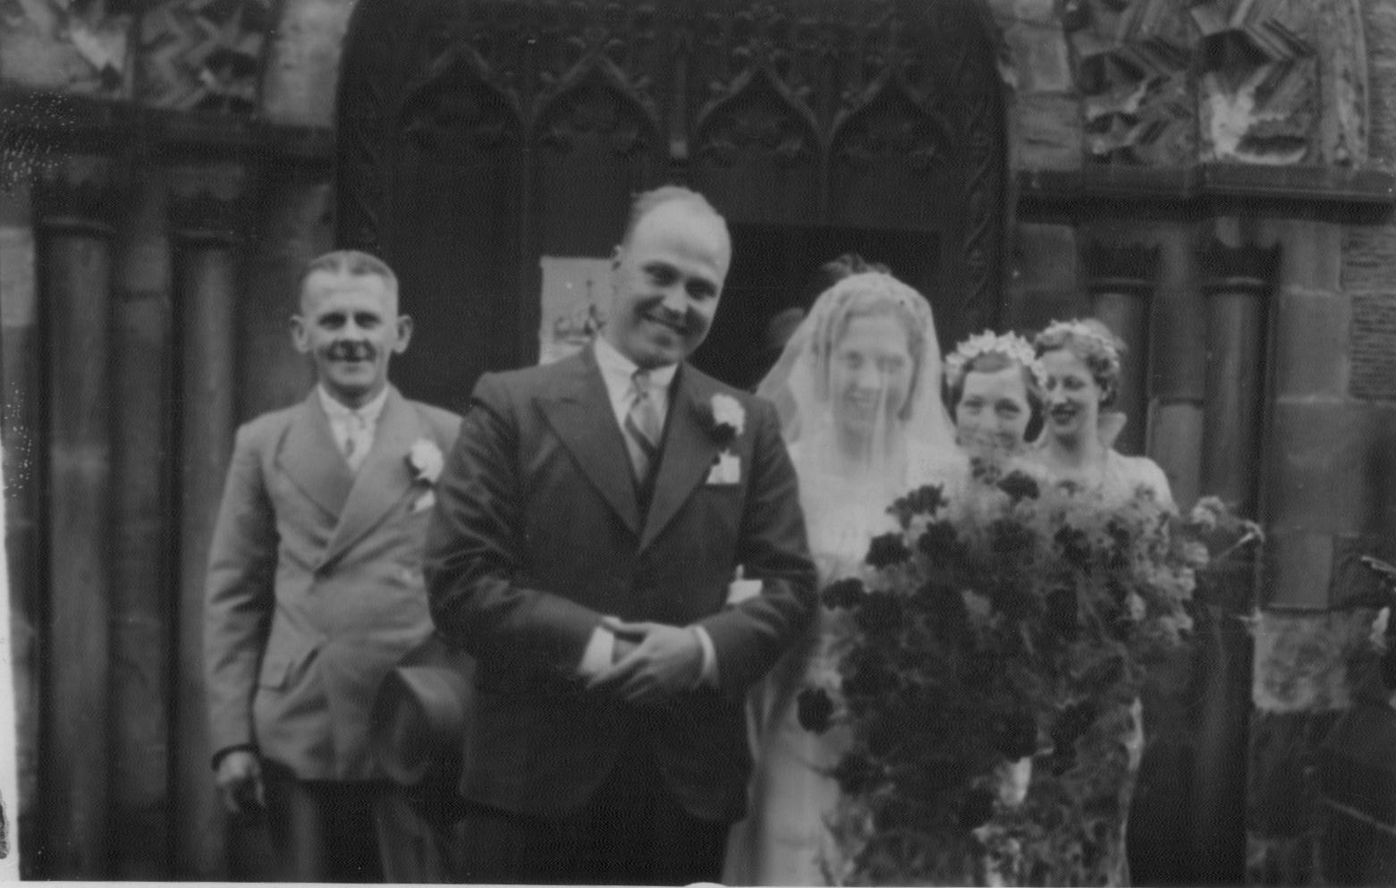
Phillip (Tubby) & Florence’s wedding day, May 6th 1939

Slide 9
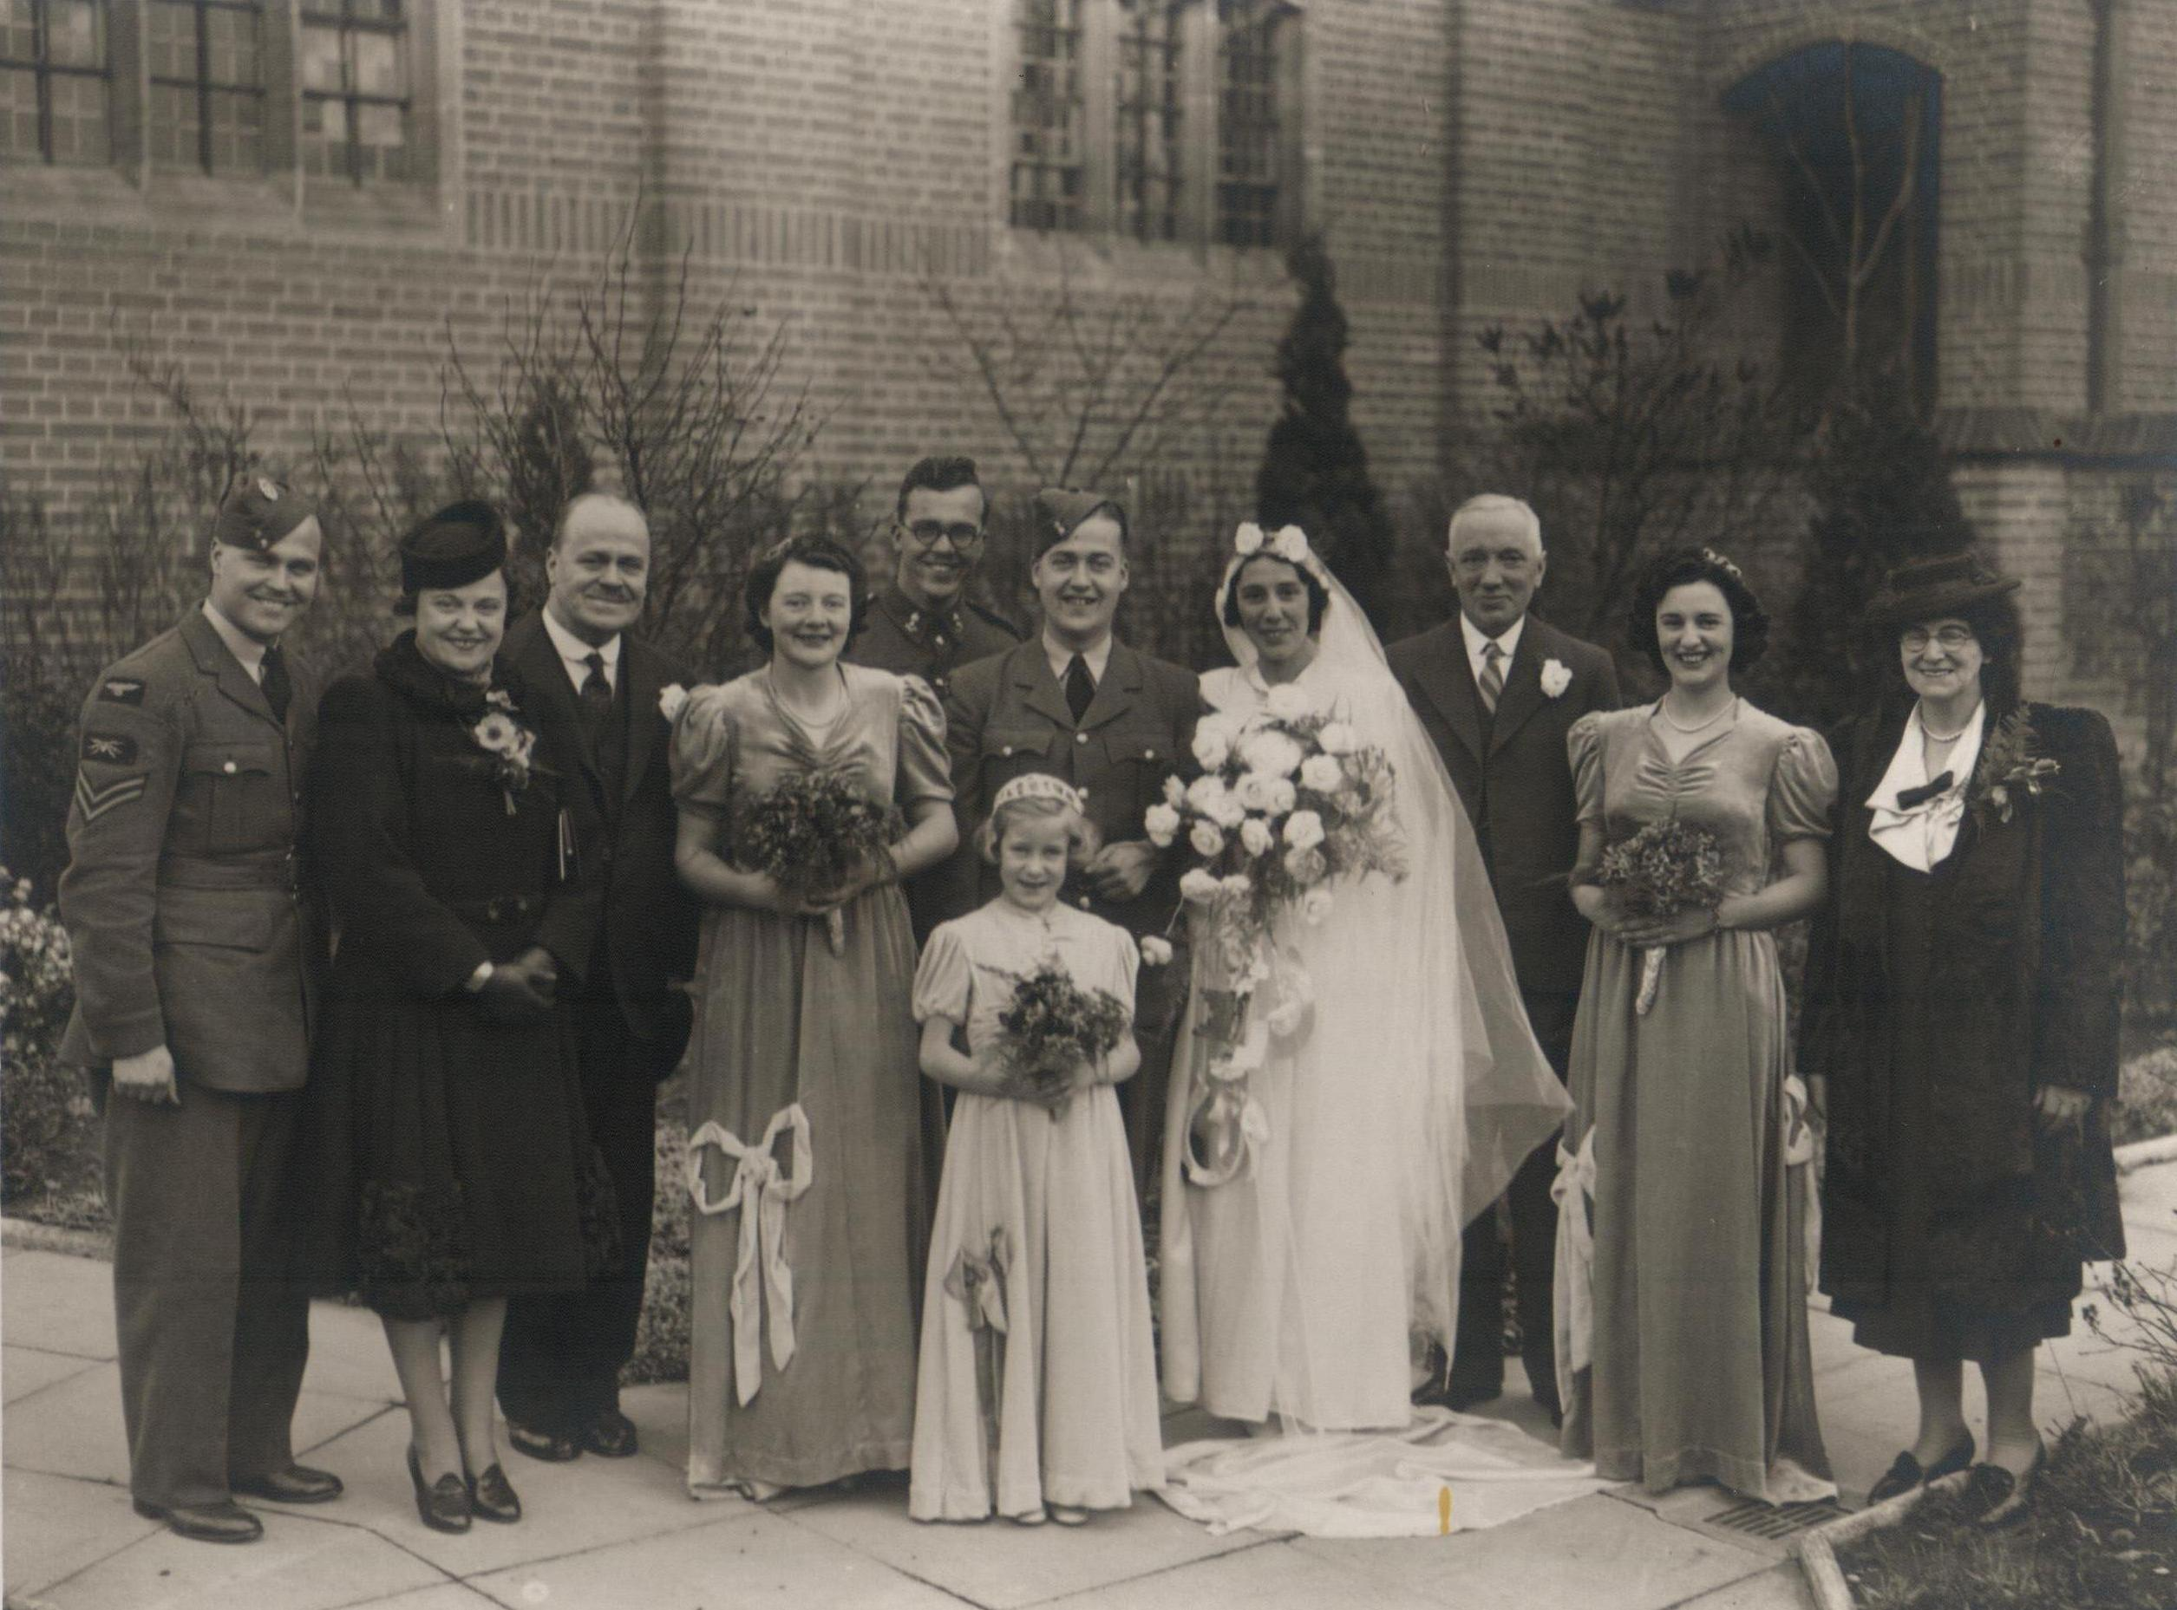
Tubby (far left) next to sister, Clarice & my grandfather, Percy at Maurice & Tilly’s wedding. November 14th 1940. Arthur, Tubby’s brother, is behind the groom with other family members.

Slide 10
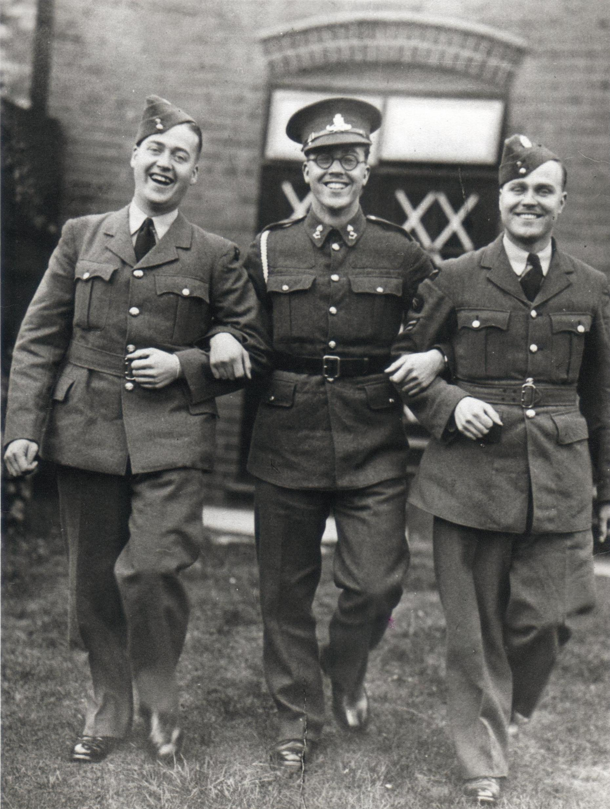
A delightful photo of all three brothers, Maurice, Arthur & Philip, at Maurice & Tilly’s wedding. November 14th 1940. Note the diagonal bomb blast tapes on windows at the rear

Slide 11
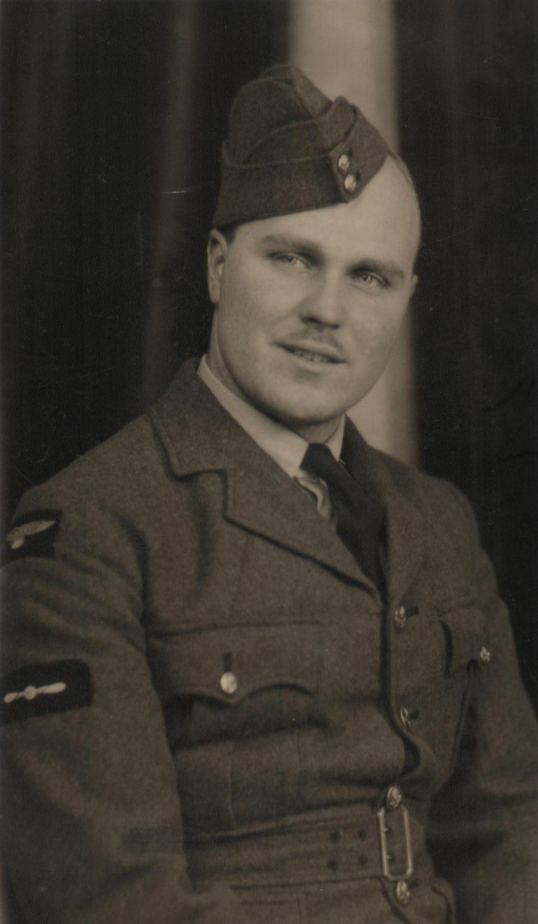
A fresh faced “Tubby”, September 1939, at Manston, Kent, during basic training

Slide 12
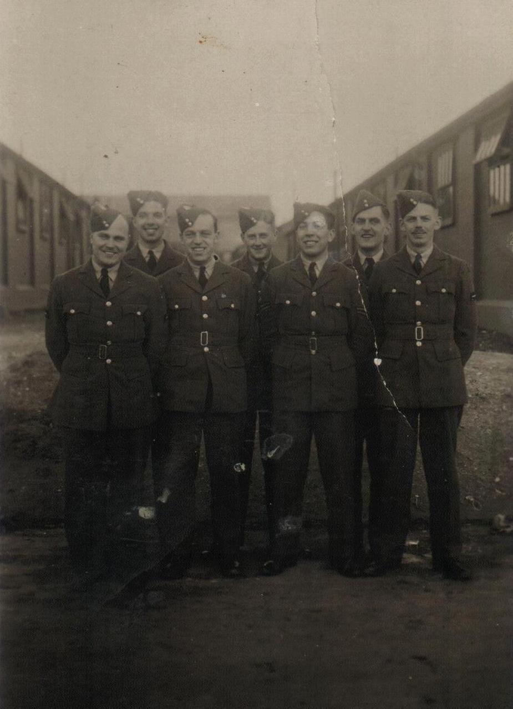
Training Starts
Manston, December 3rd, 1939. Tubby is far left, Cliff Ginnette rear left, G.Haddon far right. These seven friends all signed the photo; by September 1941, four are either missing or dead.

Slide 14
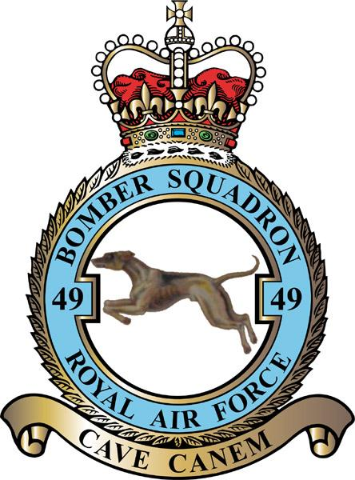
The crest of 49 Squadron.
The motto ‘CAVE CANEM’ translates as -
BEWARE OF THE DOG

Slide 15
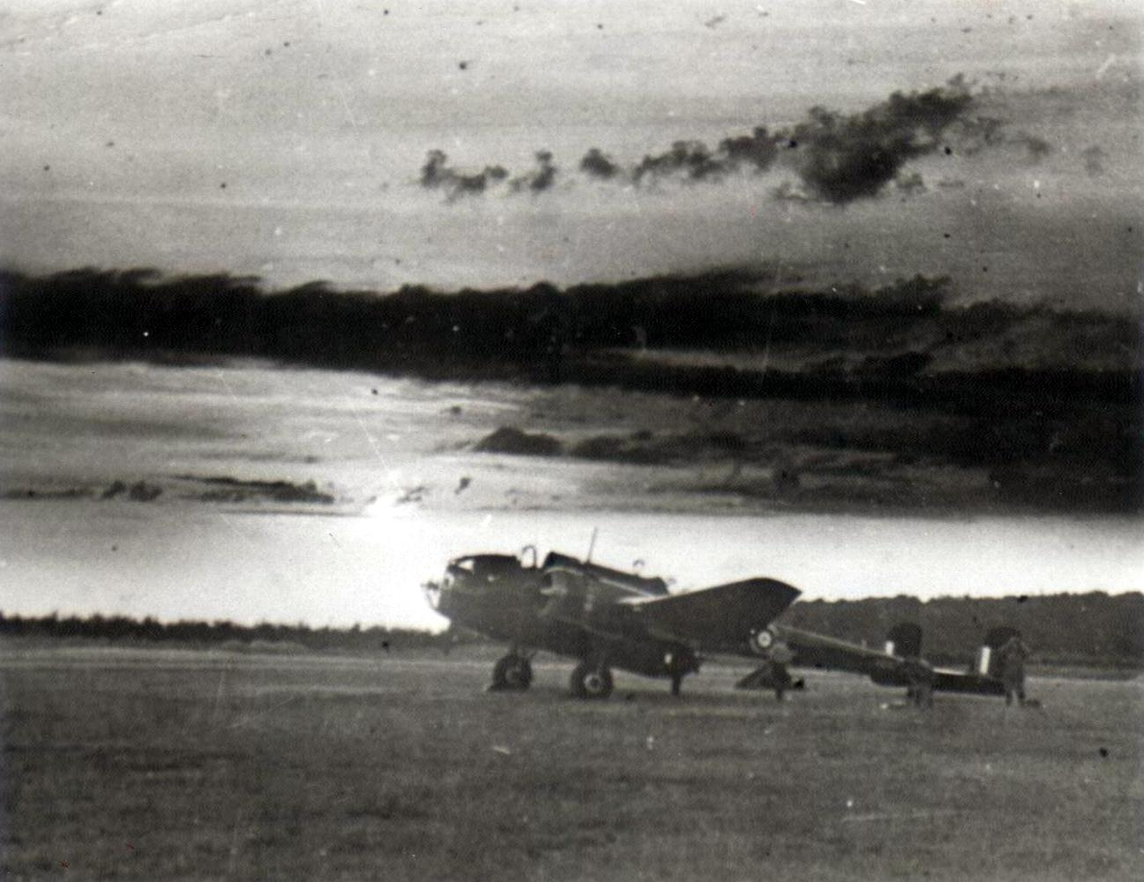
START OF OPERATIONS
Scampton operations aircraft, Hampden bomber AE187, ‘OL-L’, of 83 squadron, shot down over Holland, September 1st 1941.
Photo courtesy Doug Garton via Trevor Stocks

Slide 16
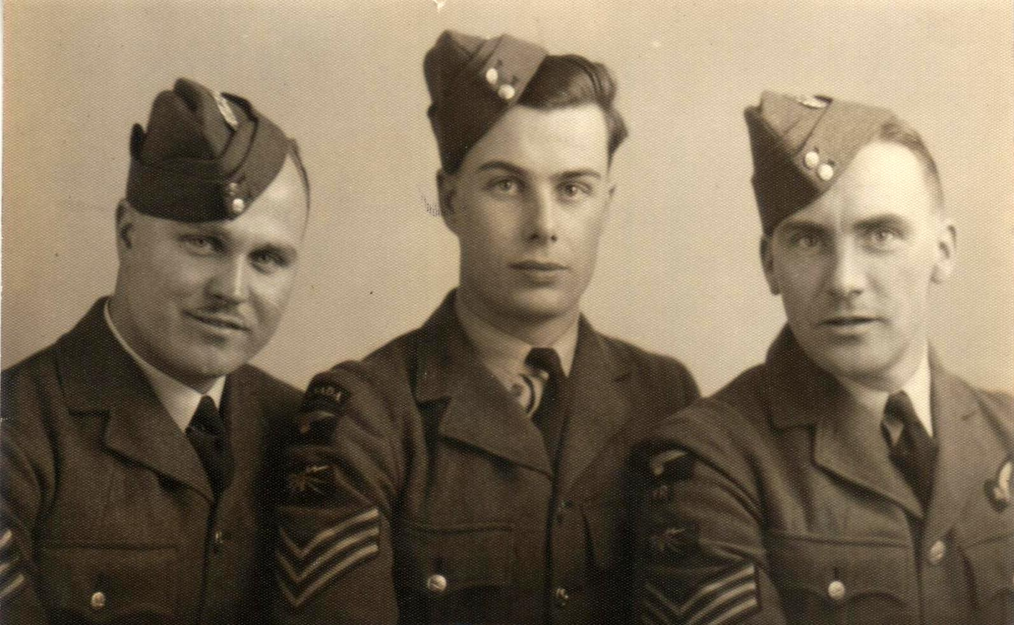
‘Tubby’ left with two unknown airmen, possibly on completion of training in January 1941.

Slide 17
Pilot Officer
WALKER, he was one of Tubby’s pilots.

Slide 18
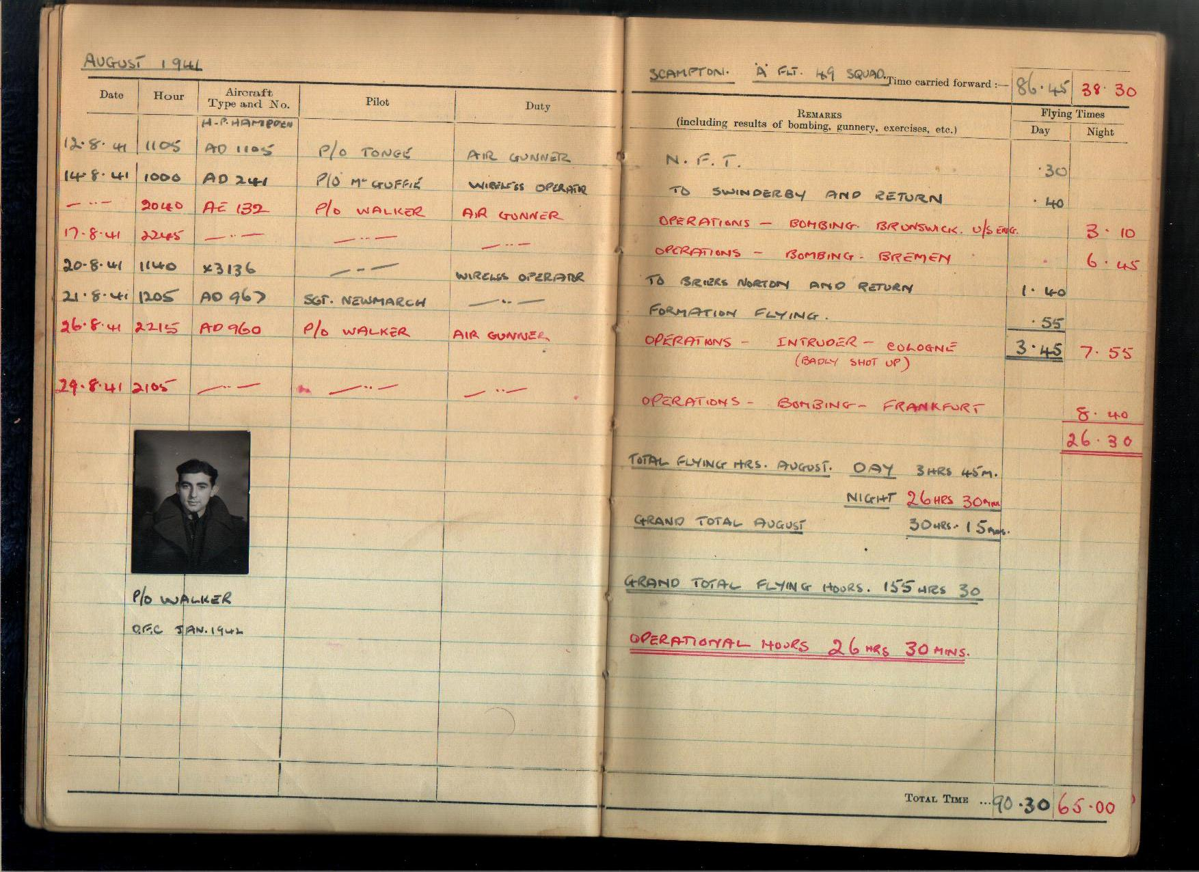

Slide 19
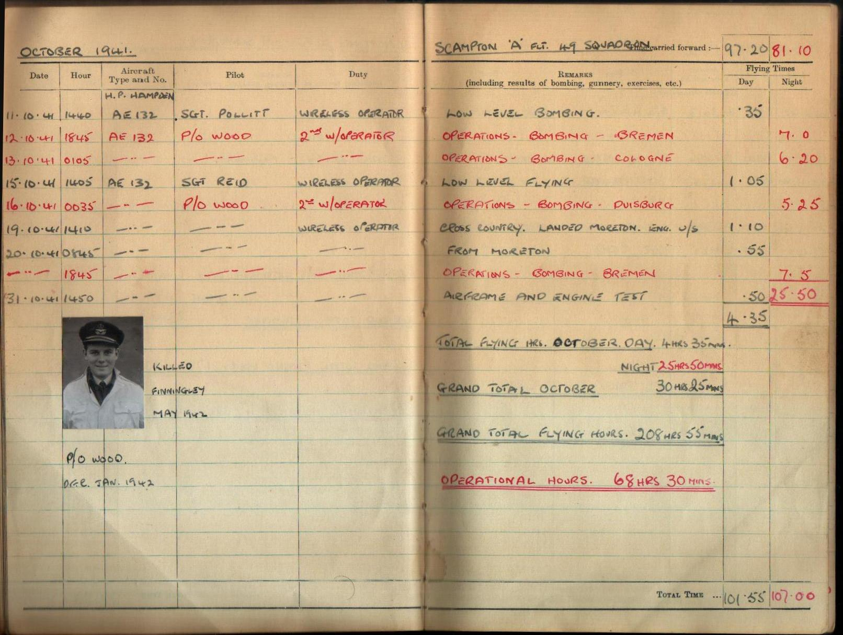

Slide 20
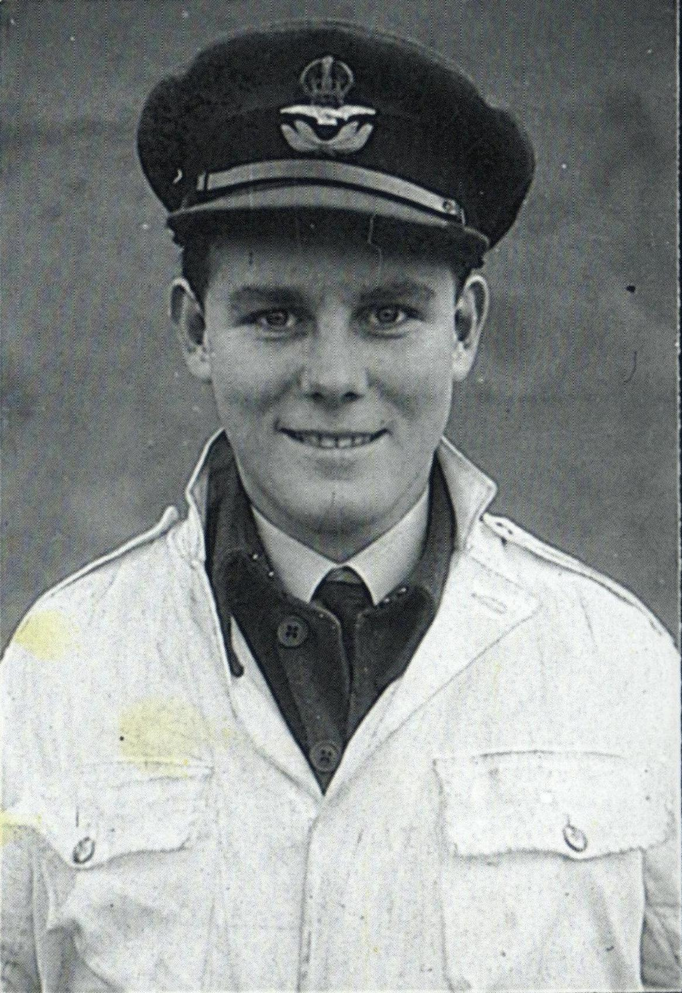
P / O Wood
(killed November 1941)

Slide 21
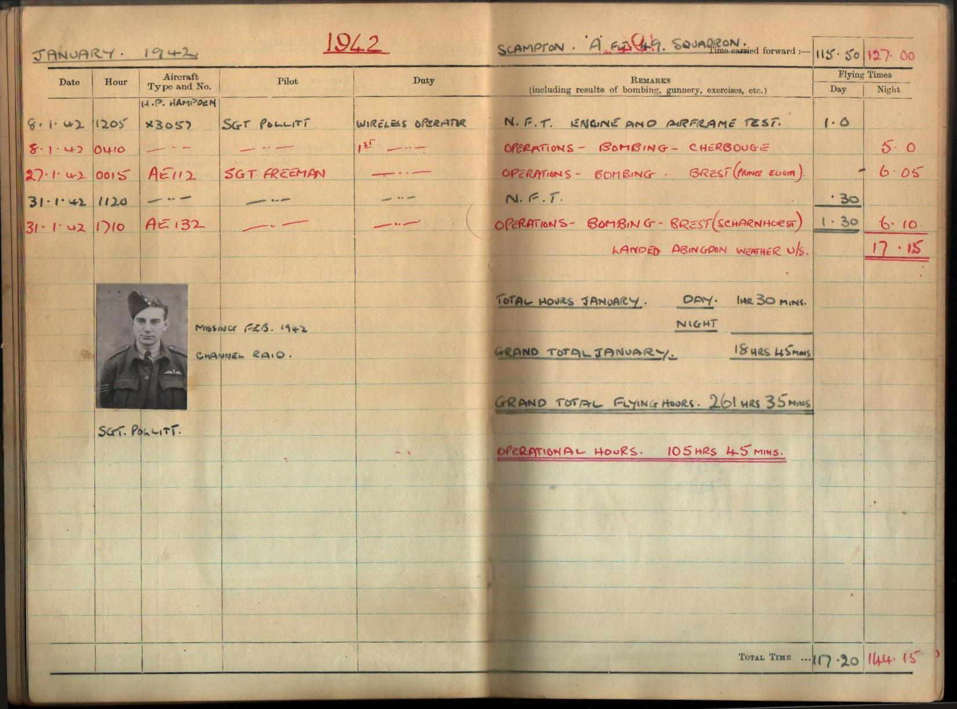

Slide 22
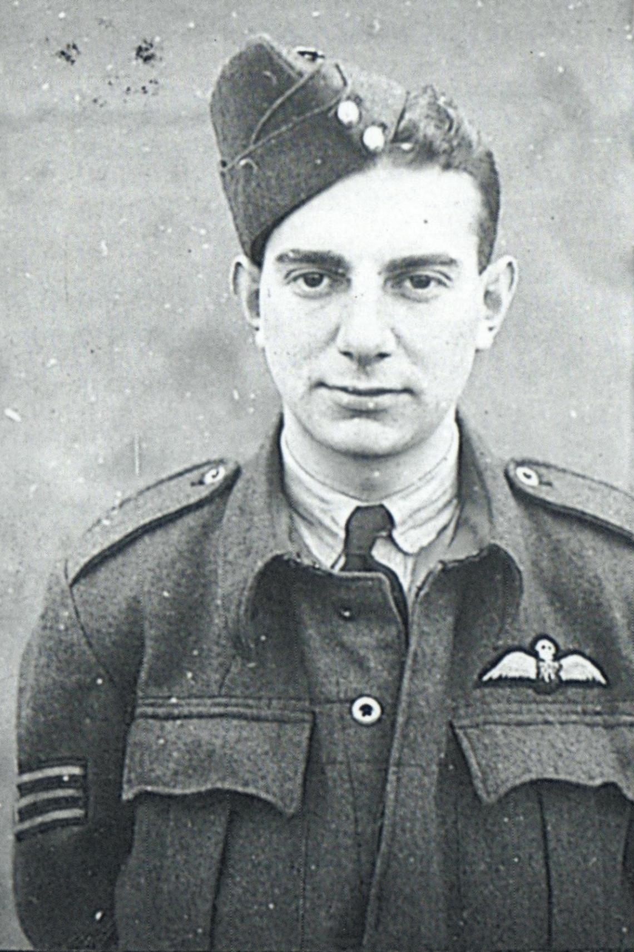
Flight Sergeant Pollitt,
Tubby’s pilot on the
Cherbourg raid,
missing on February
12th 1942, Channel raid.

Slide 23
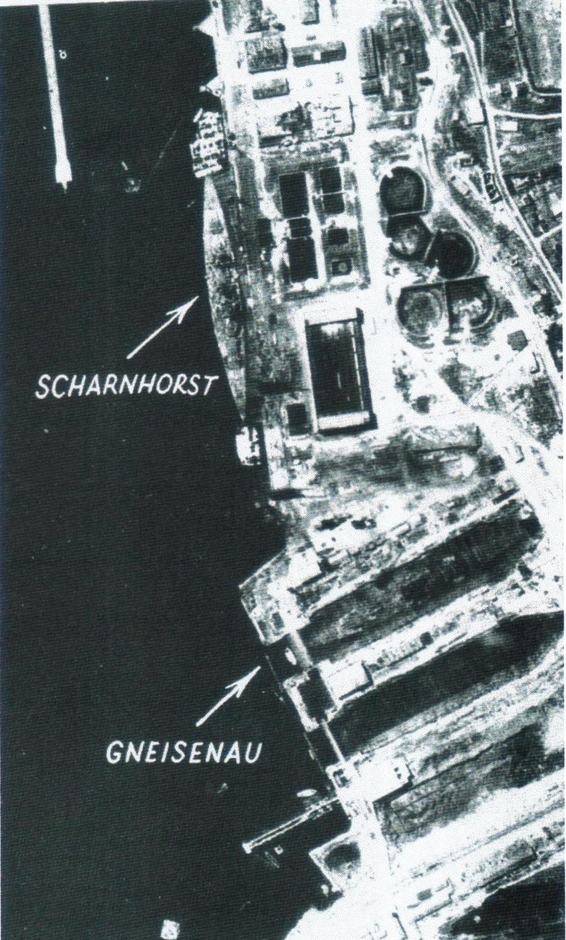
The German warships
‘ Scharnhorst & Gneisenau’
in Brest harbour,
July 21st, 1941.
Photo courtesy George Web.

Slide 24
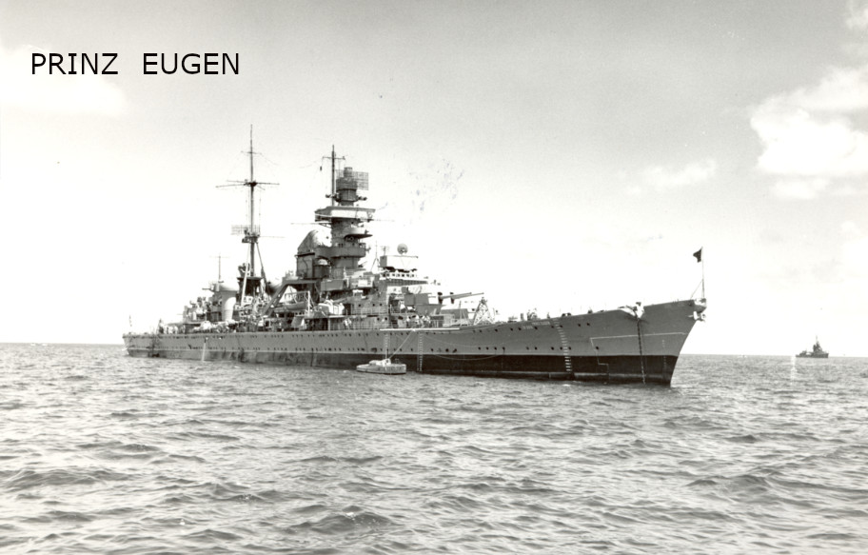

Slide 25
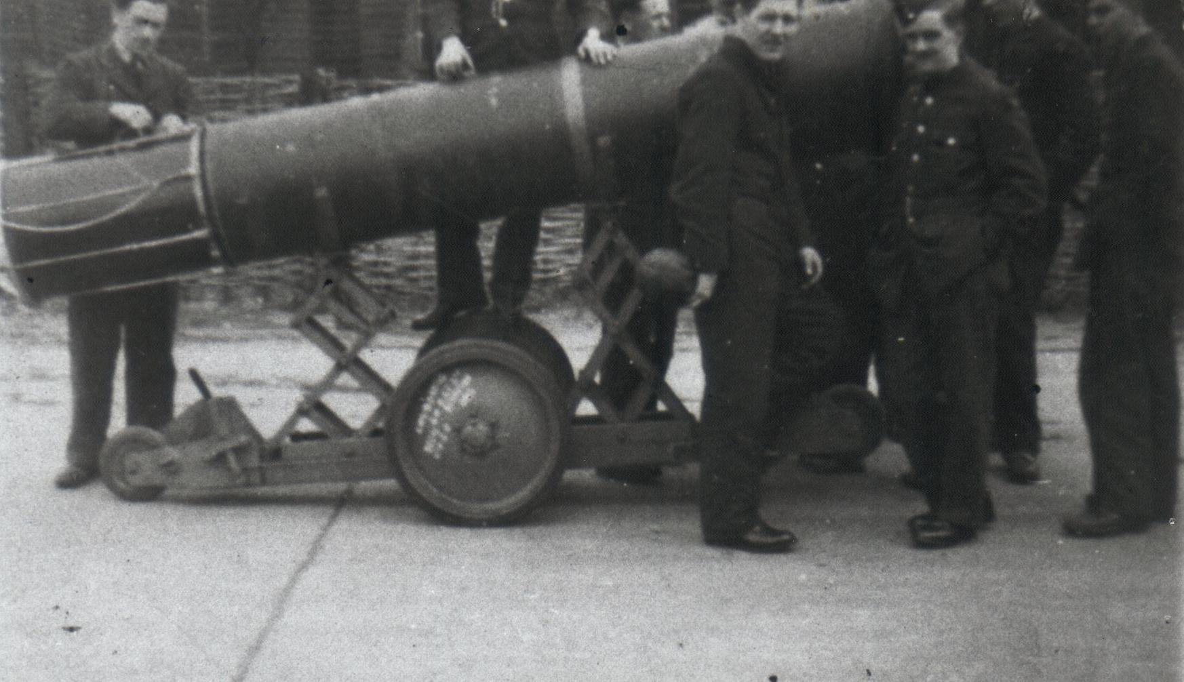
Trevor Stocks, 1940, with other ground crew, standing at the left parachute-end of a 2,000 lb mine as used on ‘gardening operations’. Sadly, Tam Murrey standing on wheel fusing the mine, was killed in a later fusing accident at this bomb dump in 1941.
Photo courtesy Trevor Stocks

Slide 26
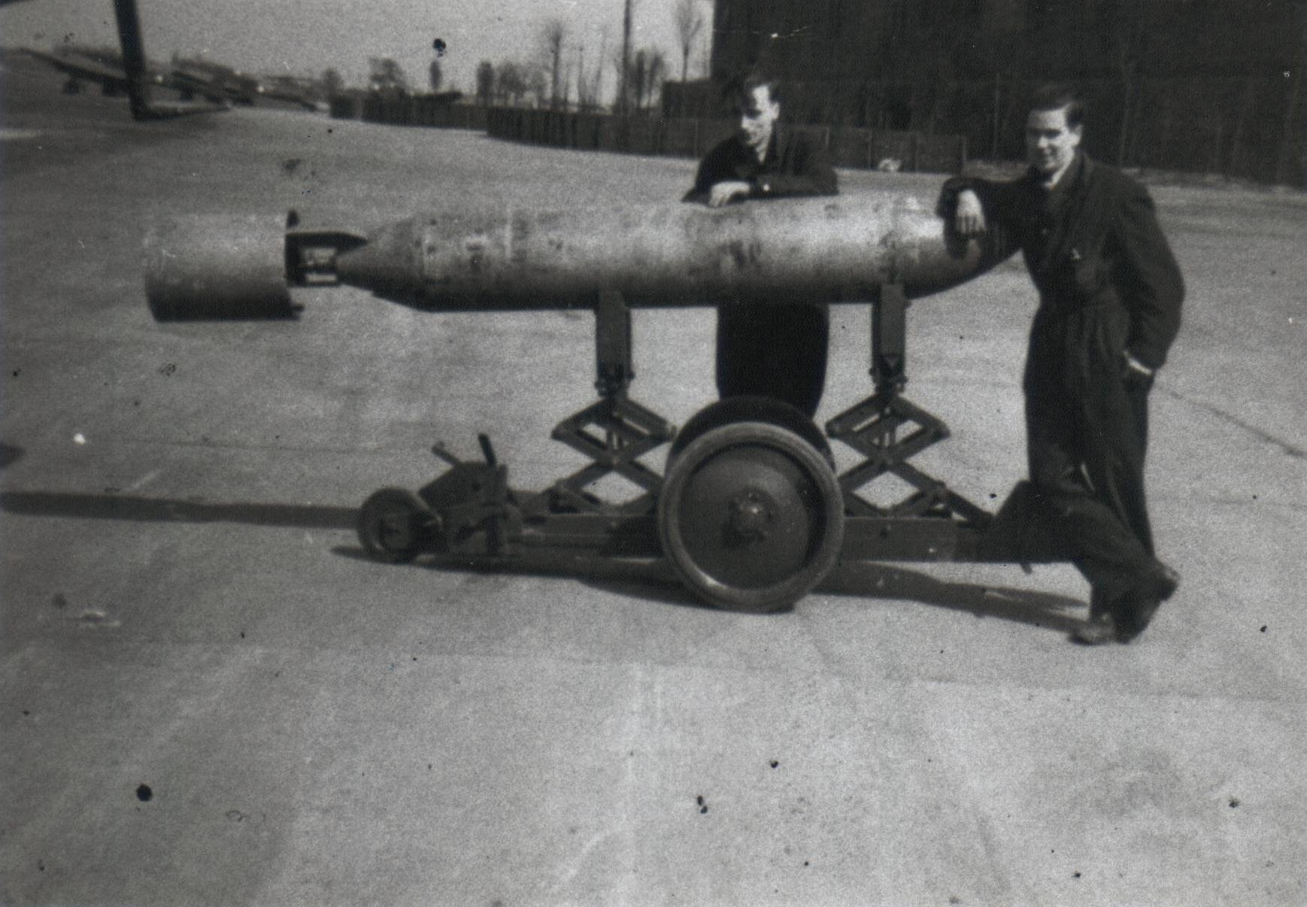
Trevor Stocks & Corporal Tam Murray with a 2,000 lb armour piercing bomb, as used against the Scharnhorst, outside No. 3 hanger.
Photo courtesy Trevor Stocks

Slide 27
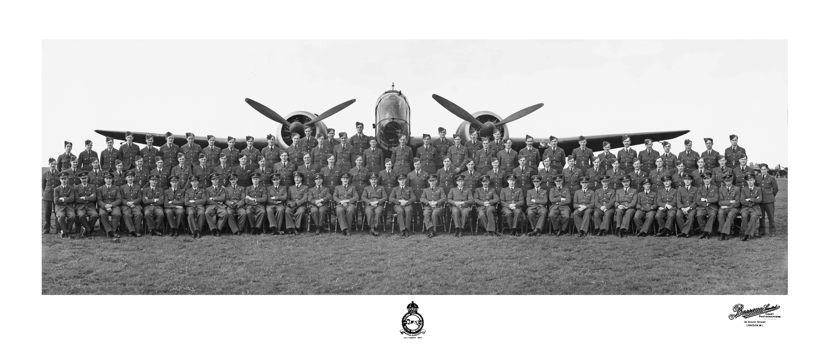
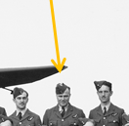
49 Sqn & Hampden, 1941, Tubby 3rd from right, back row.

Slide 28
Aircraft Hampden AD896:
Tony Pointer (Wireless Operator and Air Gunner), far right with his first crew.
Dave Block (pilot),
Brian Hugget (navigator), &
Jack Cameron (Wireless Operator and Air Gunner), July 25th 1941

Slide 29
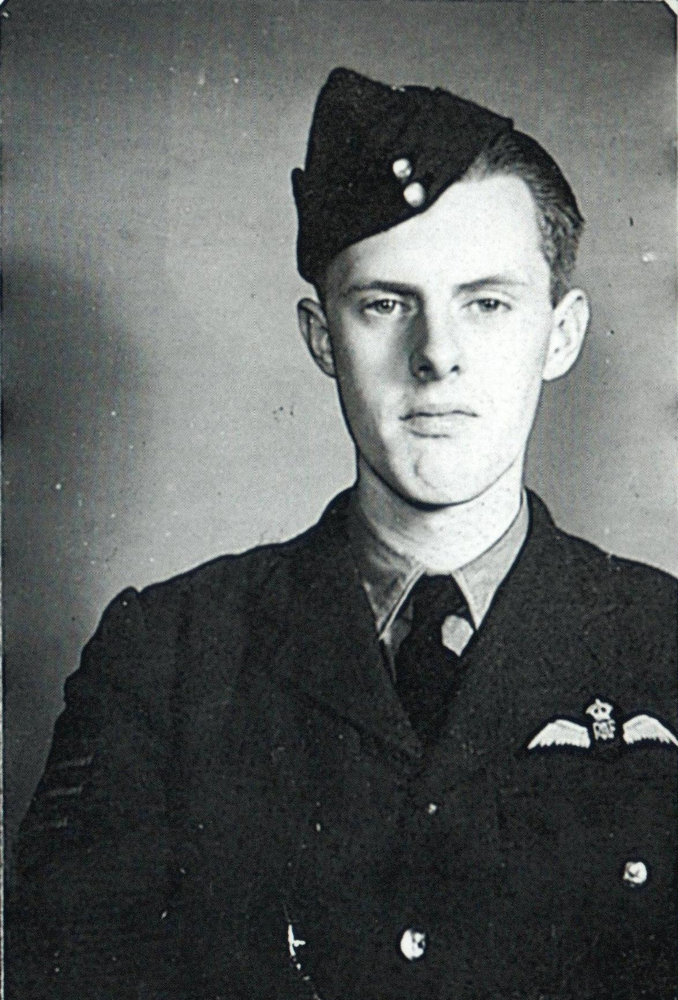
Sergeant Hamer,
Tubby’s pilot on
the Huls raid.

Slide 30
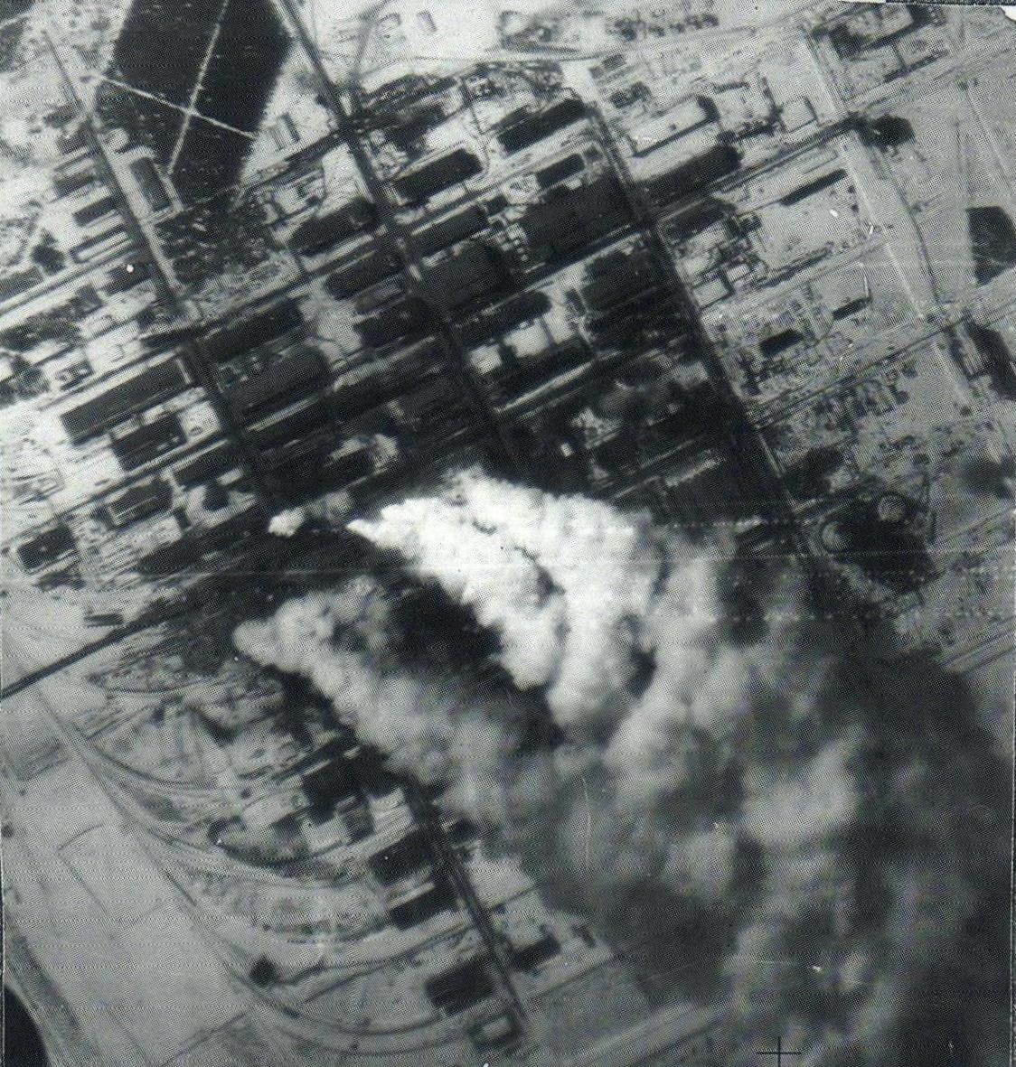
Huls synthetic oil plant, photographed from Tubby’s aircraft following direct hits, made on the December 28th 1941.

Slide 31
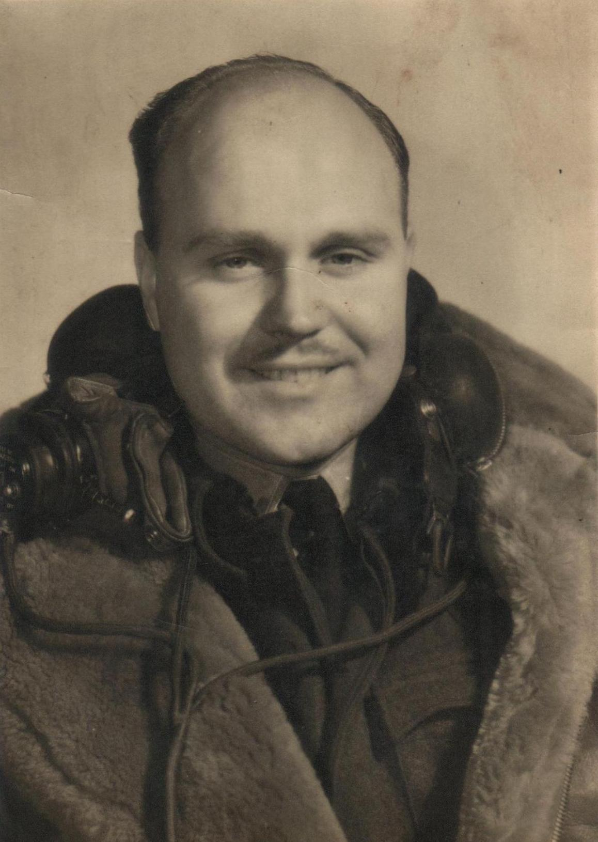
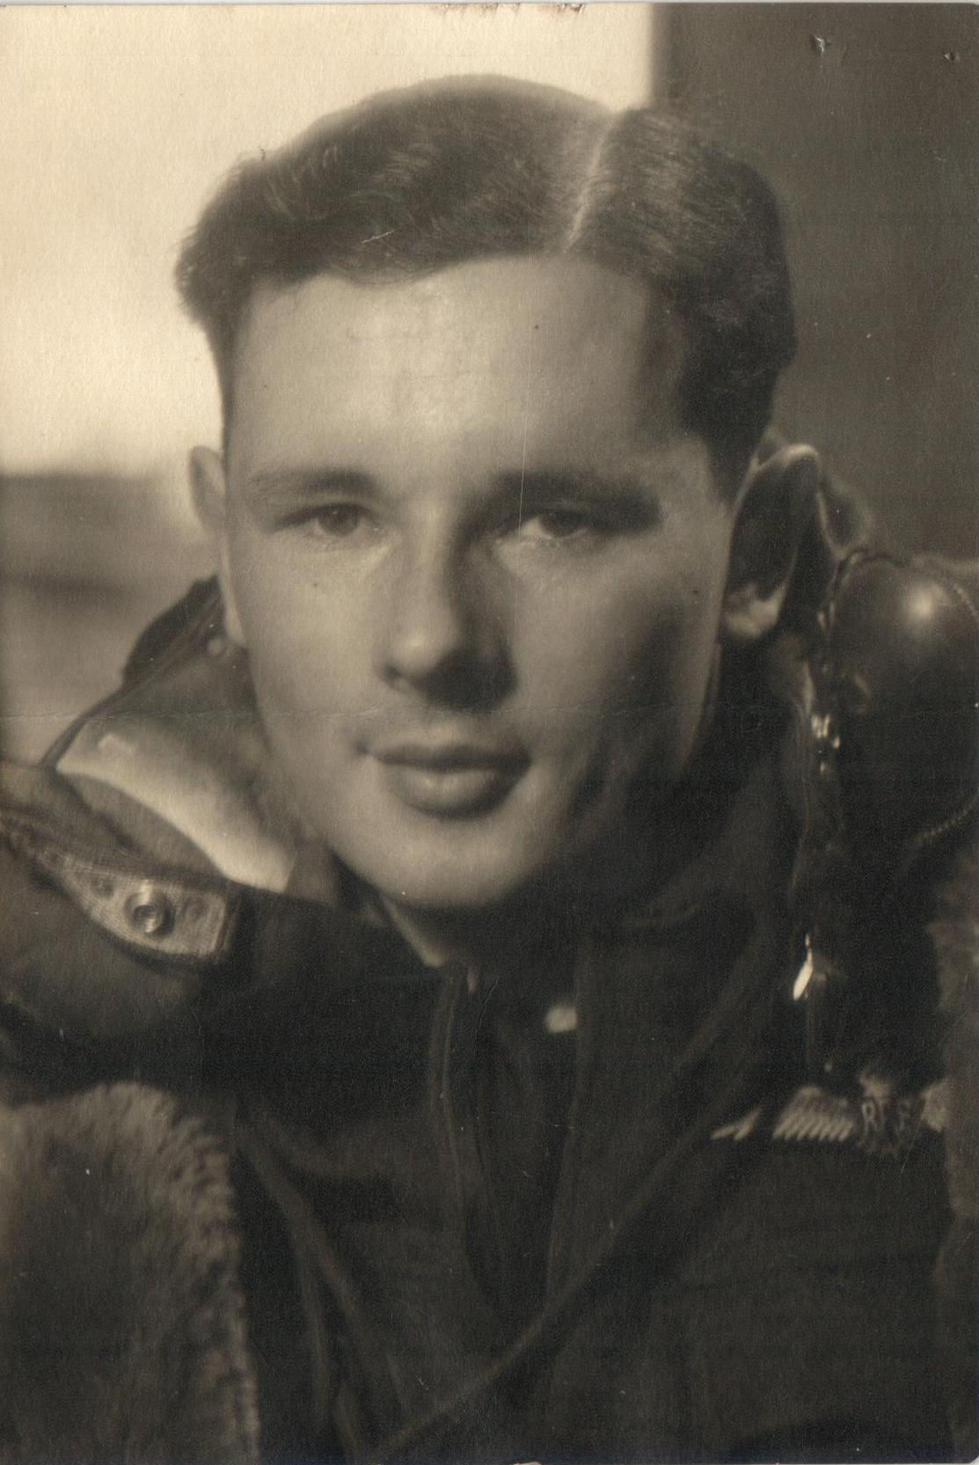
Tubby, end of first tour; April 1942.
Sgt Terry Freeman, end of tour; April 1942.

Slide 32
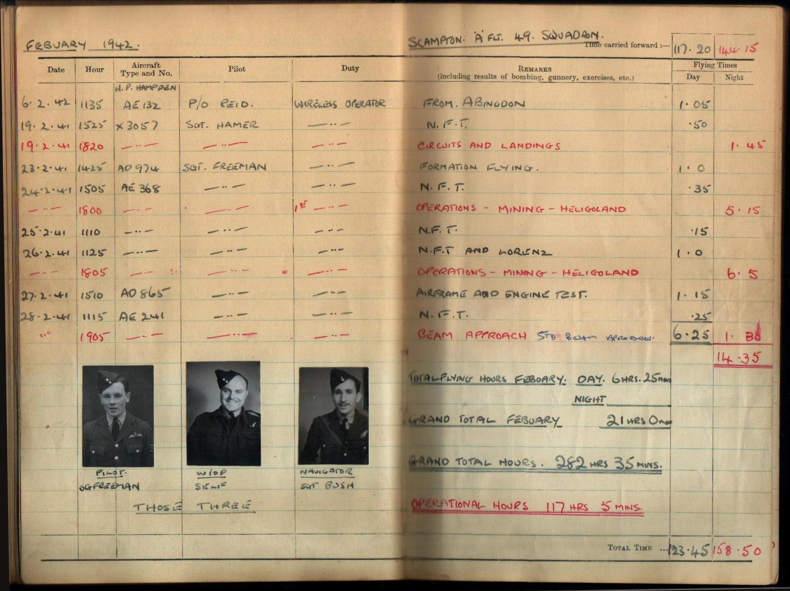

Slide 33
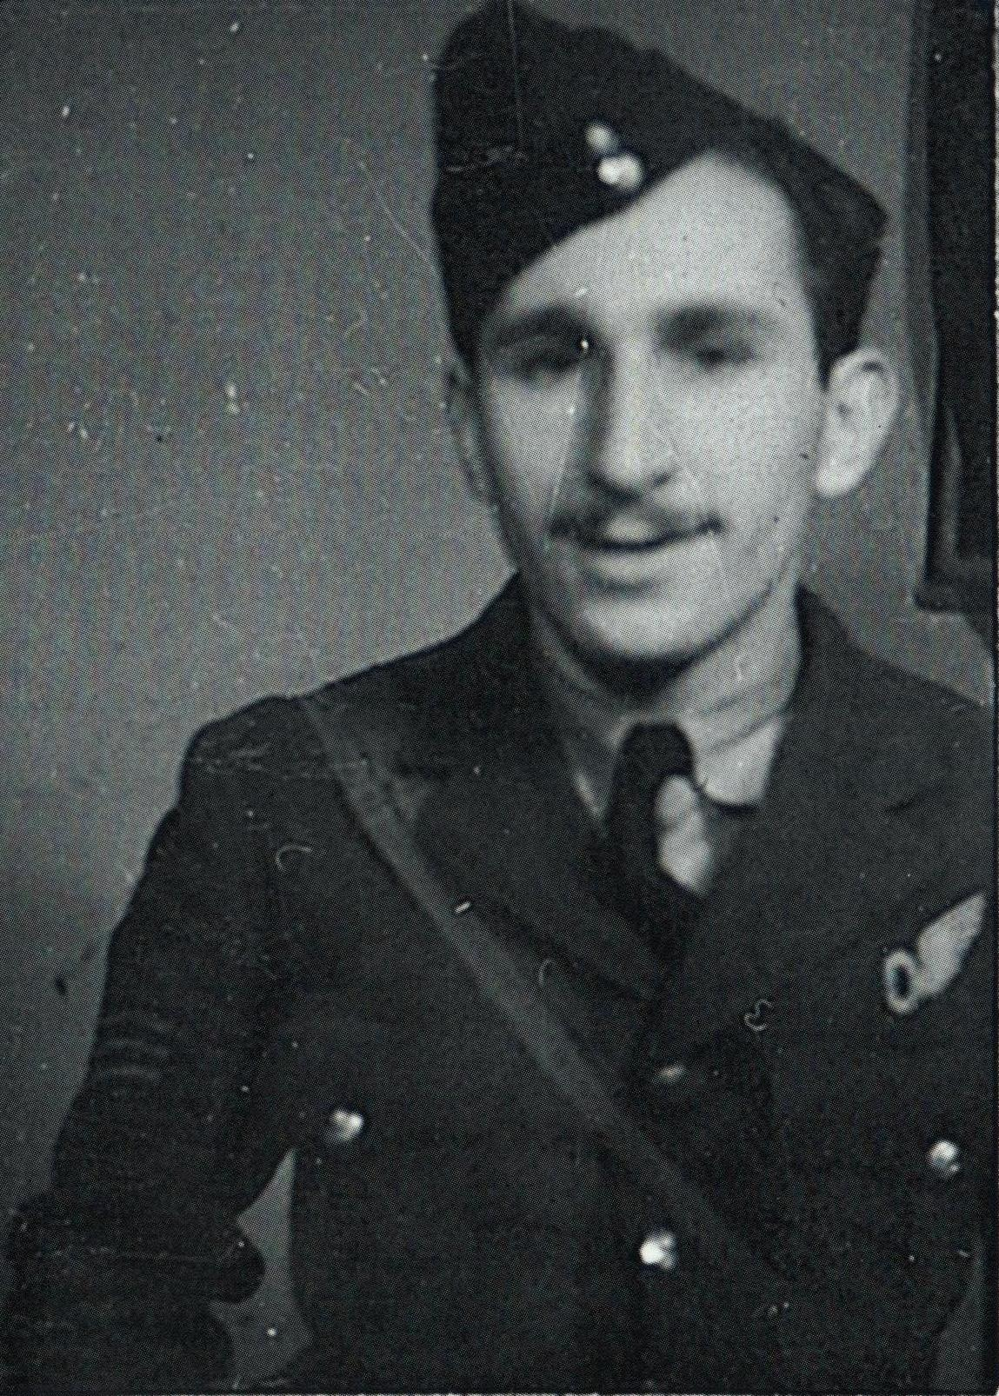
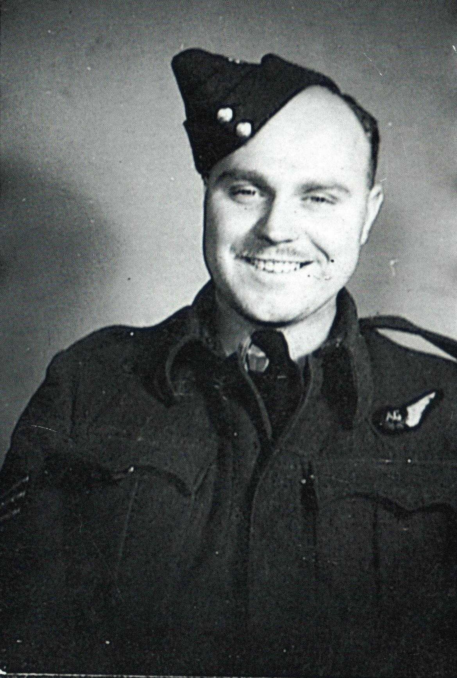
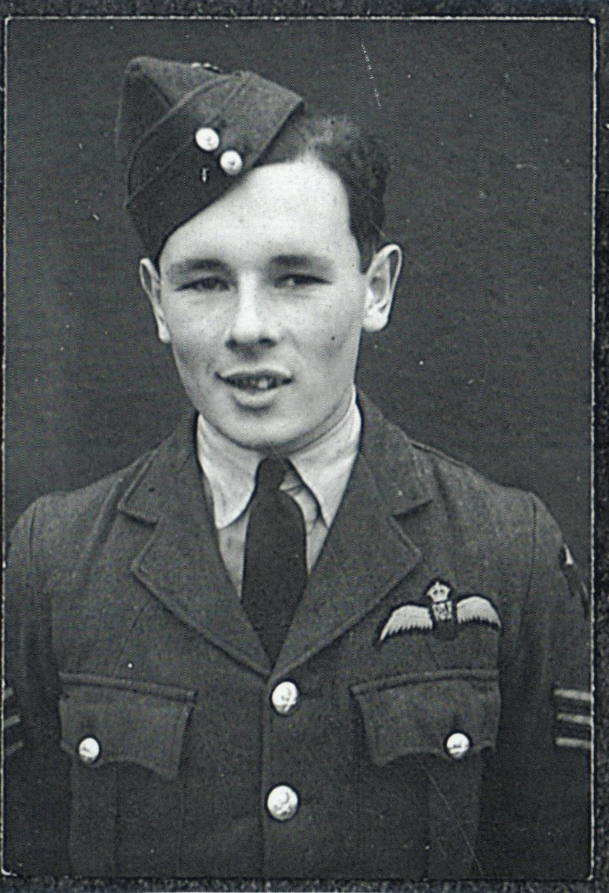
Sgt Ken Bush killed 1944.
Tubby, 1941
Sgt Terry Freeman (Tubby’s pilot) 1942

Slide 34
Propaganda leaflet dropped to German civilians showing the amount of allied bombs being dropped on Germany in comparison to those being dropped by the Nazis on the allies.

Slide 35
Handley Page Hampden

Slide 36
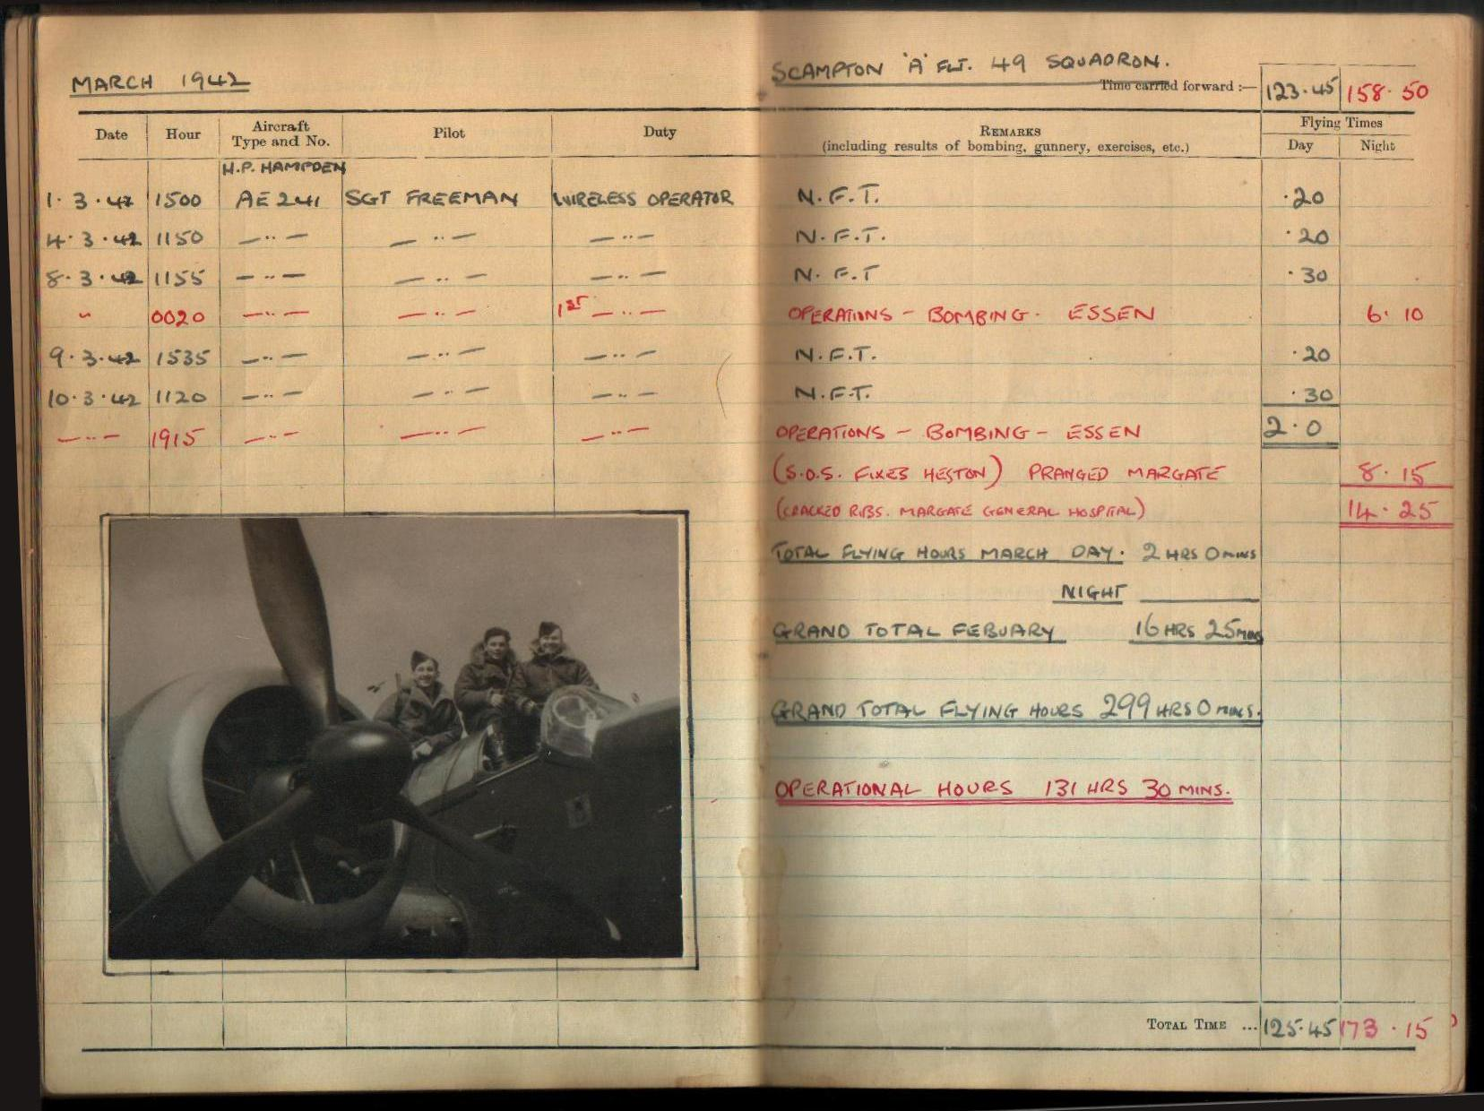

Slide 37
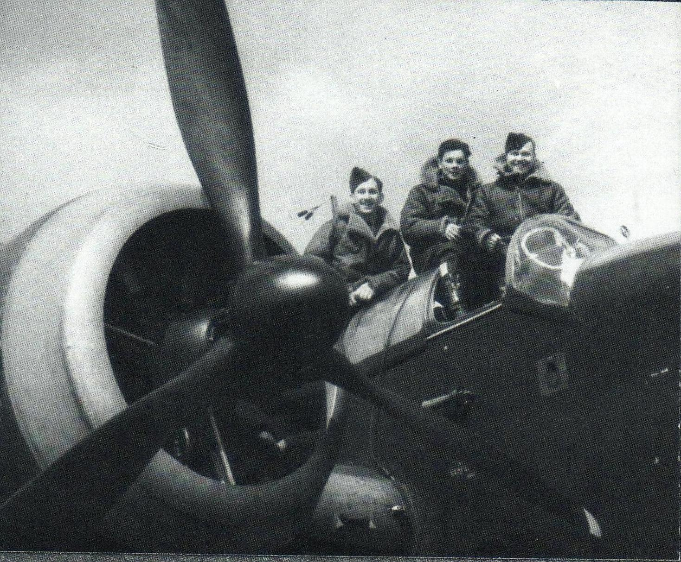
SUPERB ! (and highly unofficial) study of Tubby, Ken & Terry on Hampden bomber AE132

Slide 38
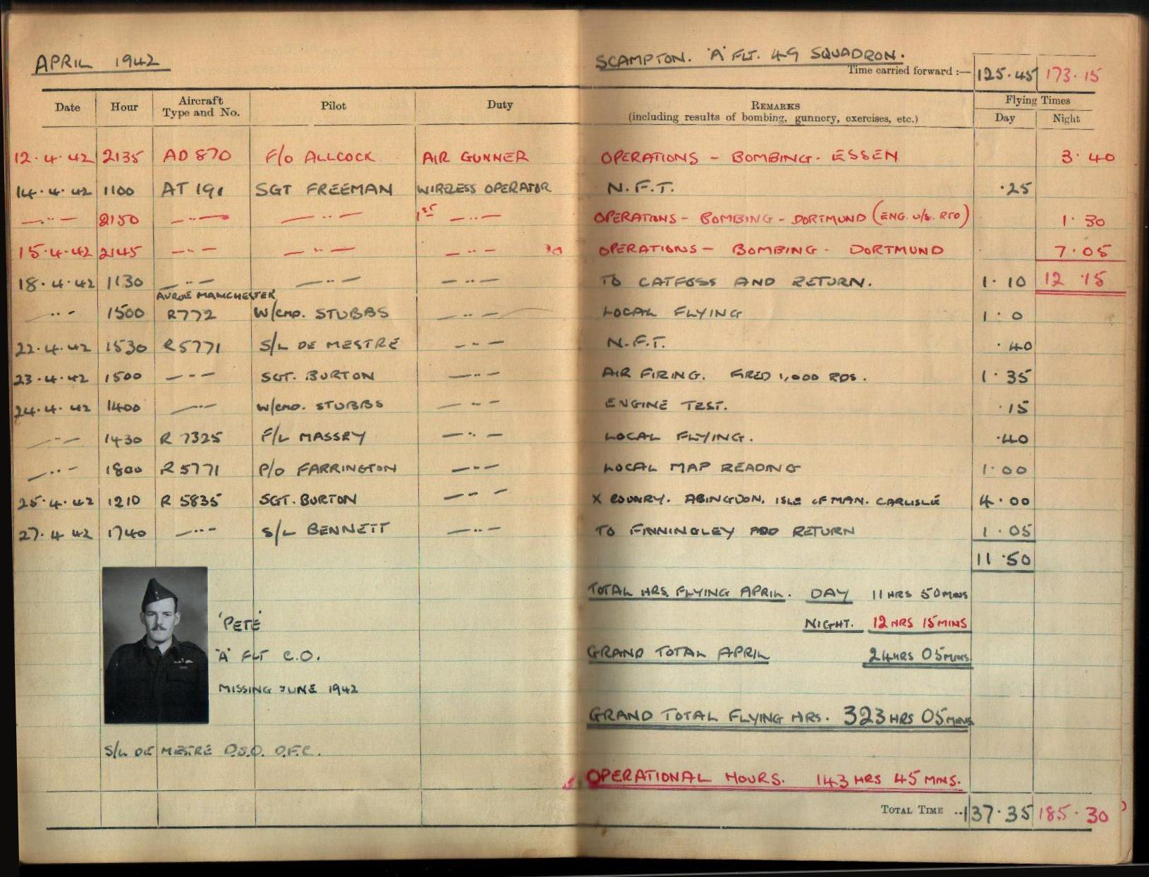

Slide 39
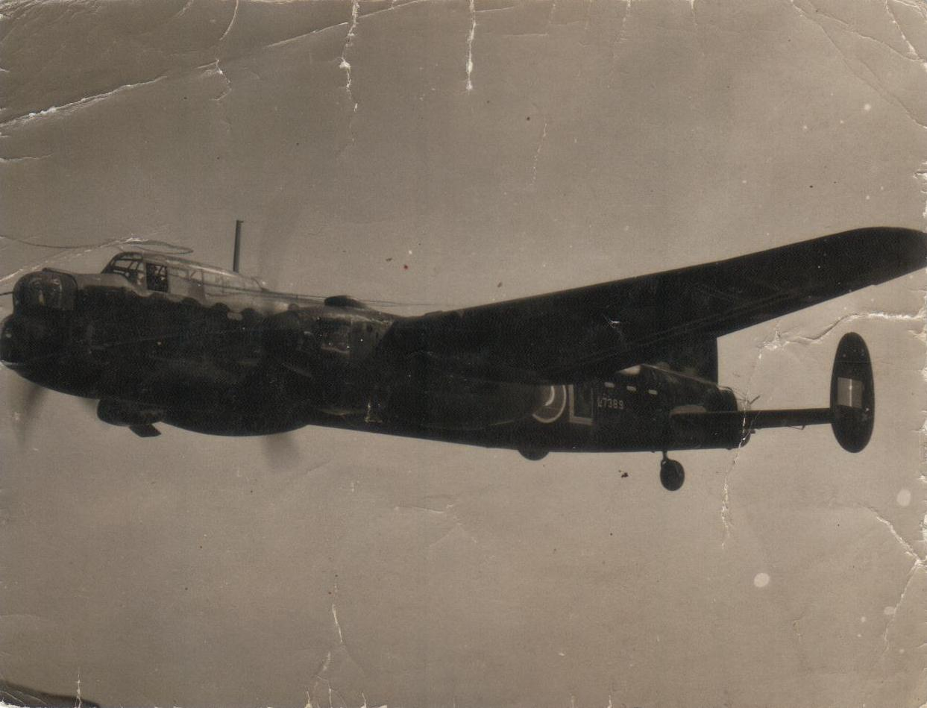
Arrival of the Manchester and the start of conversion training.
Tubby on a training flight as a wireless operator in Manchester L7398, June 1942 with the station’s “Top Brass”

Slide 40
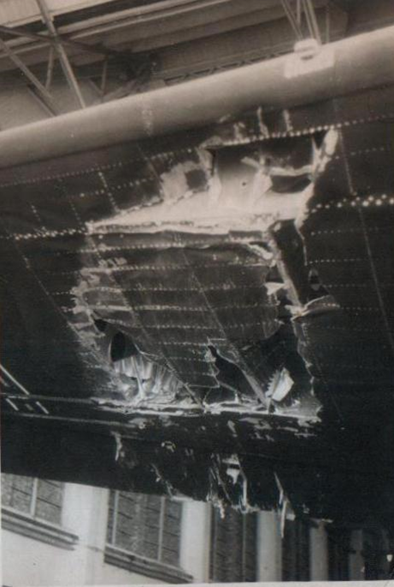
Damage to starboard wing of Manchester L7287, ‘EA-G’ after Mid-Air Collision (With Lancaster from 83 Sqn. (the 49th’s sister squadron)) over Grantham

Slide 41
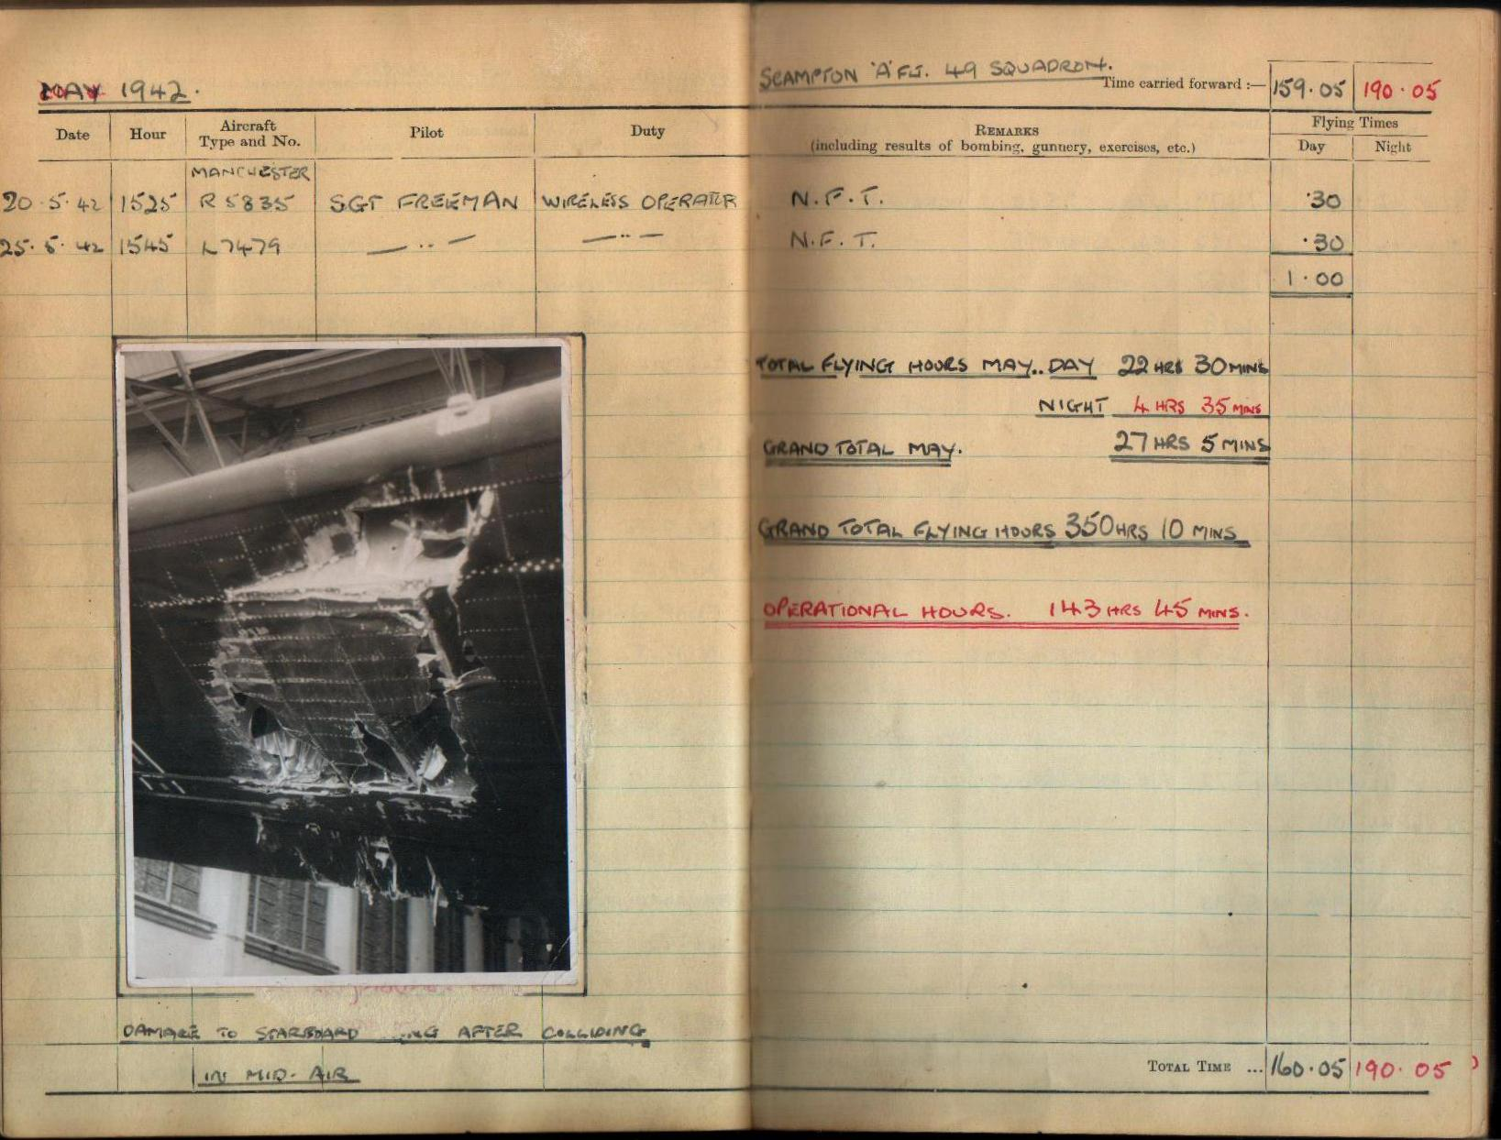

Slide 42
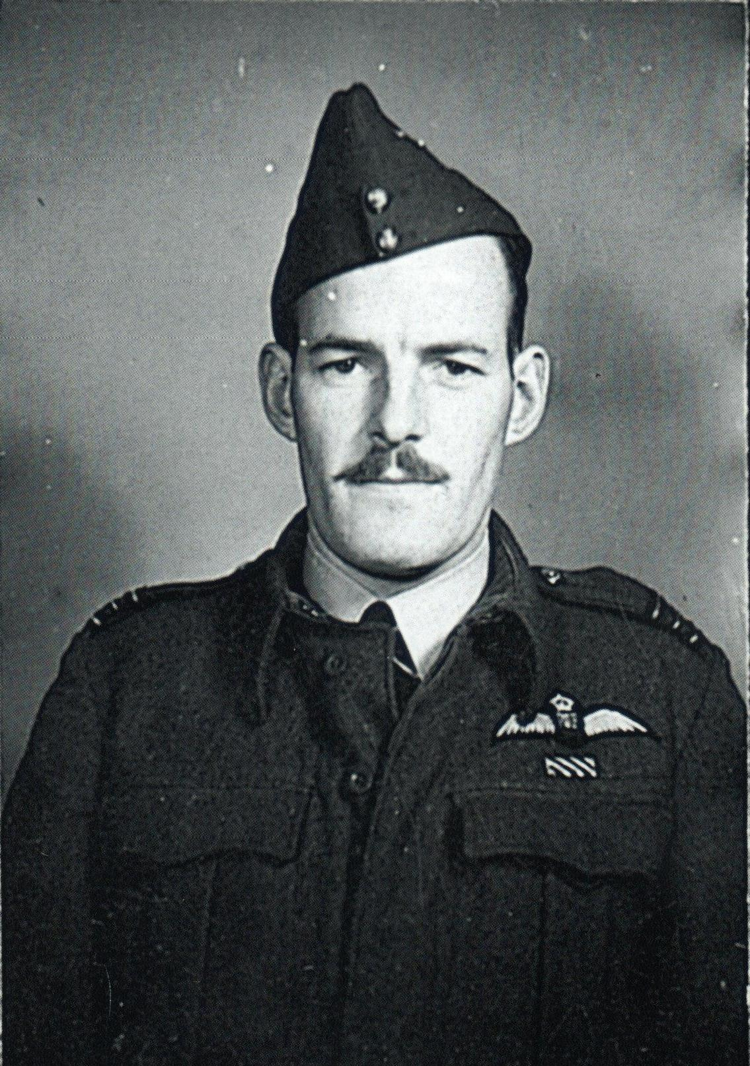
Squadron Leader Peter De Mestre DSO, DFC, 49 Sqn. One of Tubby’s pilots, he was killed on June 7th 1942, whilst converting from Hampdens to Manchester’s

Slide 43
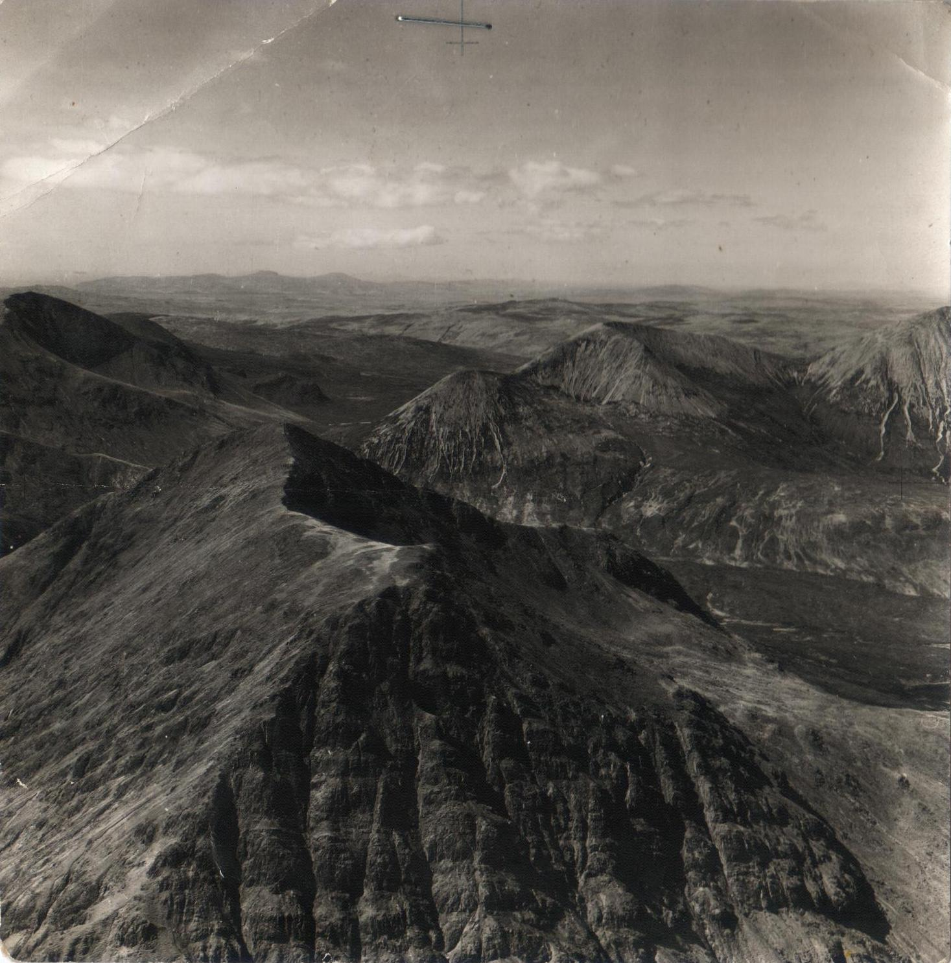
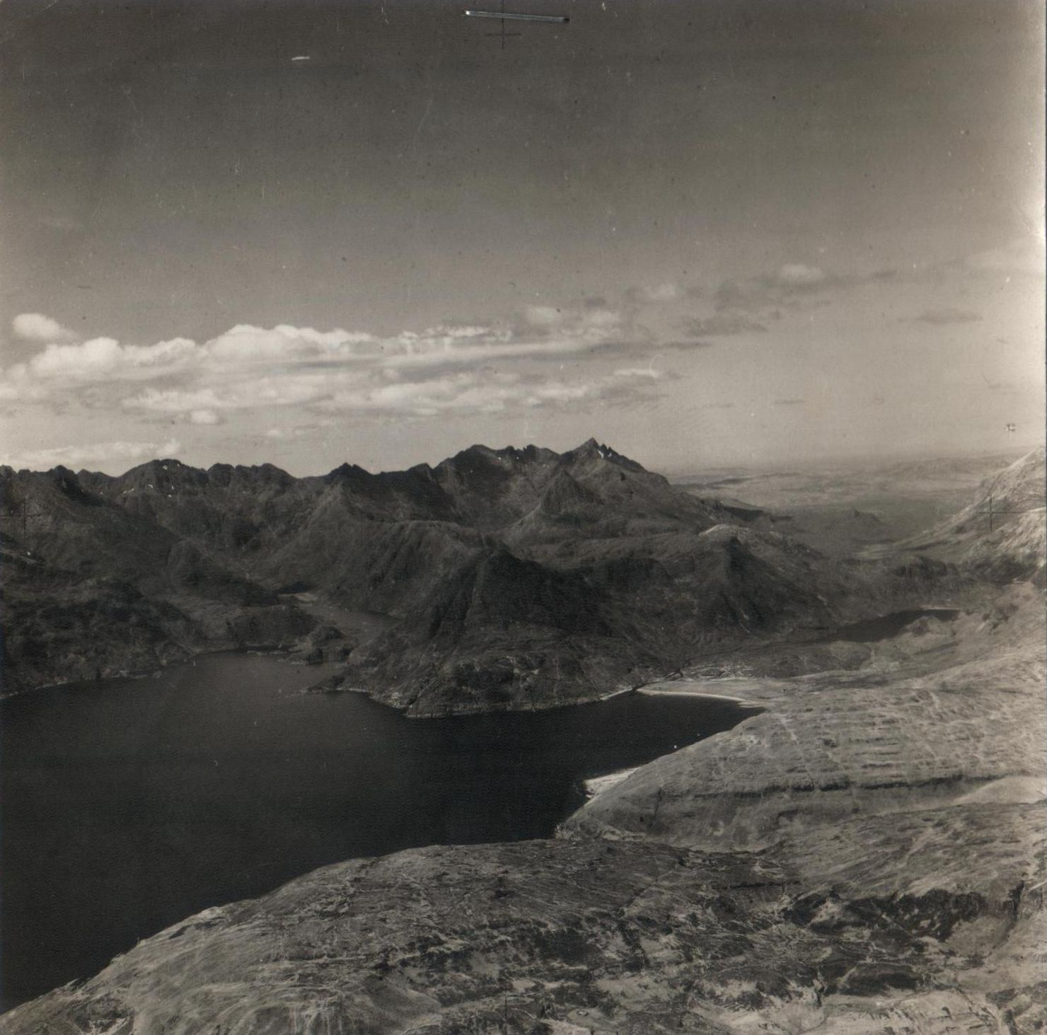
Snaps of the Isle of Sky, taken from the same Manchester (as previous slide) and also on a training flight, April 1942

Slide 44
Following his time flying in Manchester’s and after 5hrs 25 mins flying time on Lancaster’s, Tubby was posted to No. 23 Operational Training Unit Pershore, as Wireless Ops Instructor. While there he applied for Pilot training, he was accepted and moved to No 2 Initial Training Wing at Cambridge. His studies were carried out at Magdalene College and practice flying at Marshalls Airfield.

Slide 45
Avro Lancaster, being loaded with sea mines

Slide 46
List of Operations: On targets in France and Germany in 1941 and 1942.
and
On targets in Italy and Yugoslavia in 1944 and 1945.
A total of 882 hours and 30 minutes flying time.

Slide 47
Magdalene college (“maudling”).
Tubby was accepted for pilot training, his studies were carried out at Magdalene college, and practice flying at Marshalls airfield, Cambridge.

Slide 48
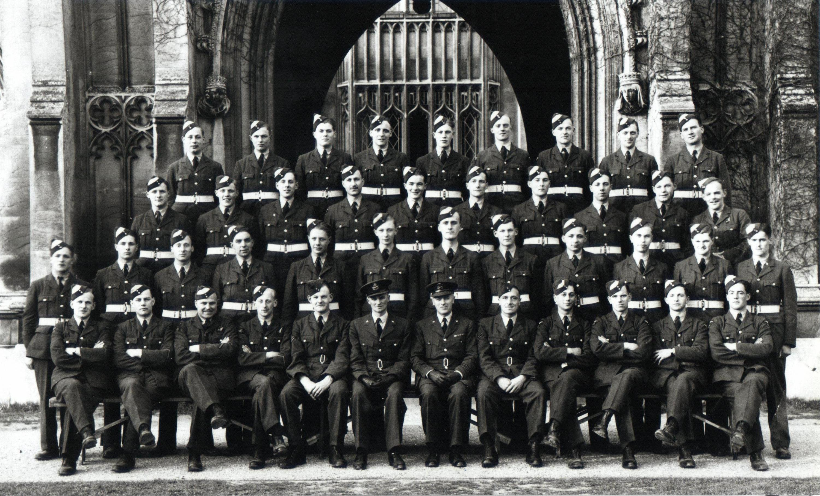
No.2 Initial Training Wing. Photographed in front of the main entrance to St. John’s New College, Cambridge, November 1942.
Photo courtesy Arthur Hornby who appears on Tubby’s right.
Tubby

Slide 49
Troop Ship
George W. Goethuls

Slide 50
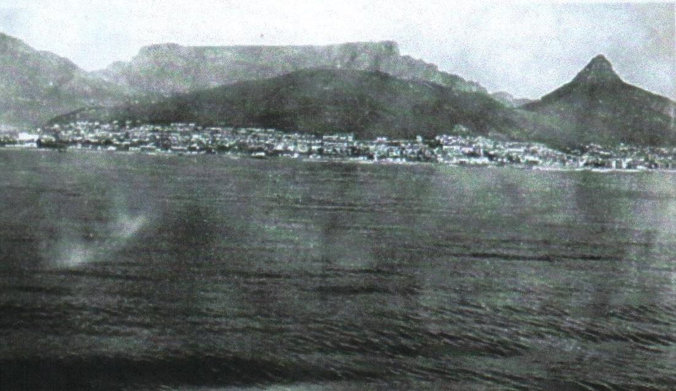
Cape Town from Liberty Ship George W. Goethuls

Slide 51
No 26 Air School, St Petersburg, No 11 War Course, April 28th, 1944. End of training. Tubby front row with Intake Winner Trophy. Norman Moseley 4th left, top but one row standing, Howard Jones, 5th left 2nd row. All three survived the war.

Slide 52
Tubby receives his ‘wings’ April 28th, 1944
Tubby receives, ‘Best of Intake’ bombing trophy
The trophy’s inscription.
A proud Tubby with his trophy

Slide 53
‘Wings Parade’, April 28th, 1944

Slide 54
New pilots arrive at No. 77 Operational Training Unit Quastina, Palestine Tubby centre of top row, Howard Jones, 2nd right of front row. This was for his training on the Wellington Bomber Mk X Photo courtesy Howard Jones

Slide 55
Dave ‘Jack’ Scanlon, Tubby’s navigator.
Maurice ‘Scats’ Sandell, Tubby’s bomb aimer.
Frank ‘Geordie’ Hazelden, Tubby’s rear gunner, 3rd from left in front row. Standing in front of an Avro Lincoln at Scampton Airfield in 1952

Slide 56
Wellington Mk X on a training flight from Quastina.
Photo courtesy Ron Cooper.

Slide 57
In the Foggia area (Southern Italy) 1944/45, mud was king, conditions were appalling.
Photos courtesy John King.

Slide 58
Excellent end of tour photo beside Wellington bomber ‘Flak Harry’: Doug Skinner’s crew at 104 Sqn, Foggia Main, 1945. From left: Wilf Eardley (nav), Charlie Williams (A/G), Jack Grey (W/Op), Doug Skinner (pilot), Jim Sterret (bomb aimer).
Photo courtesy Doug Skinner.

Slide 59
Bomb damage: Foggia, 1944.
Photo courtesy Matt Muir.

Slide 60
Sgt’s Sexton, Harry Richmond, Charlie Louch, Ringstell with ground crew, in front of Wellington Mk X ‘Scourge of the Balkans’, which completed 35 bombing sorties, one mining and five supply drops, Foggia.

Slide 61
Chart showing airfields on the Foggia Plain, & various radio beacon ‘Darky’* facilities & other navigational aids.
*‘Darky’ was a system of radio signals whereby an aircraft that was lost could get assistance to return to base.

Slide 62
Sgt Norman Moseley and crew, 37 Sqn, Tortorella (Foggia). From
left: Peter Boulton (nav), Bill Ward (W/Op), Moseley (pilot),
John Bell (bomb aimer), John Flockhart (rear gunner).
Photo courtesy Norman Moseley.

Slide 63
Sgt Bob Foster (left) with
his father, Canada, 1943,
who was the Station Commander
& presented Bob
with his A/G brevet.
Bob Foster (2nd left, top) with
Sgt Duncan & other aircrew in
London, 1944.
Bob Foster & an u/k
aircrew, Tortorella olive
grove, 1944.
The grave of Sgt Duncan, Bob’s
pilot, Bari, Italy, November 15th,
1945.

Slide 64
Bob Foster pictured with his fellow barber shop singers in 1996.

Slide 65
One of the Ploesti oil fields
after a visit from Foggia based
squadrons, 1943/44.

Slide 66
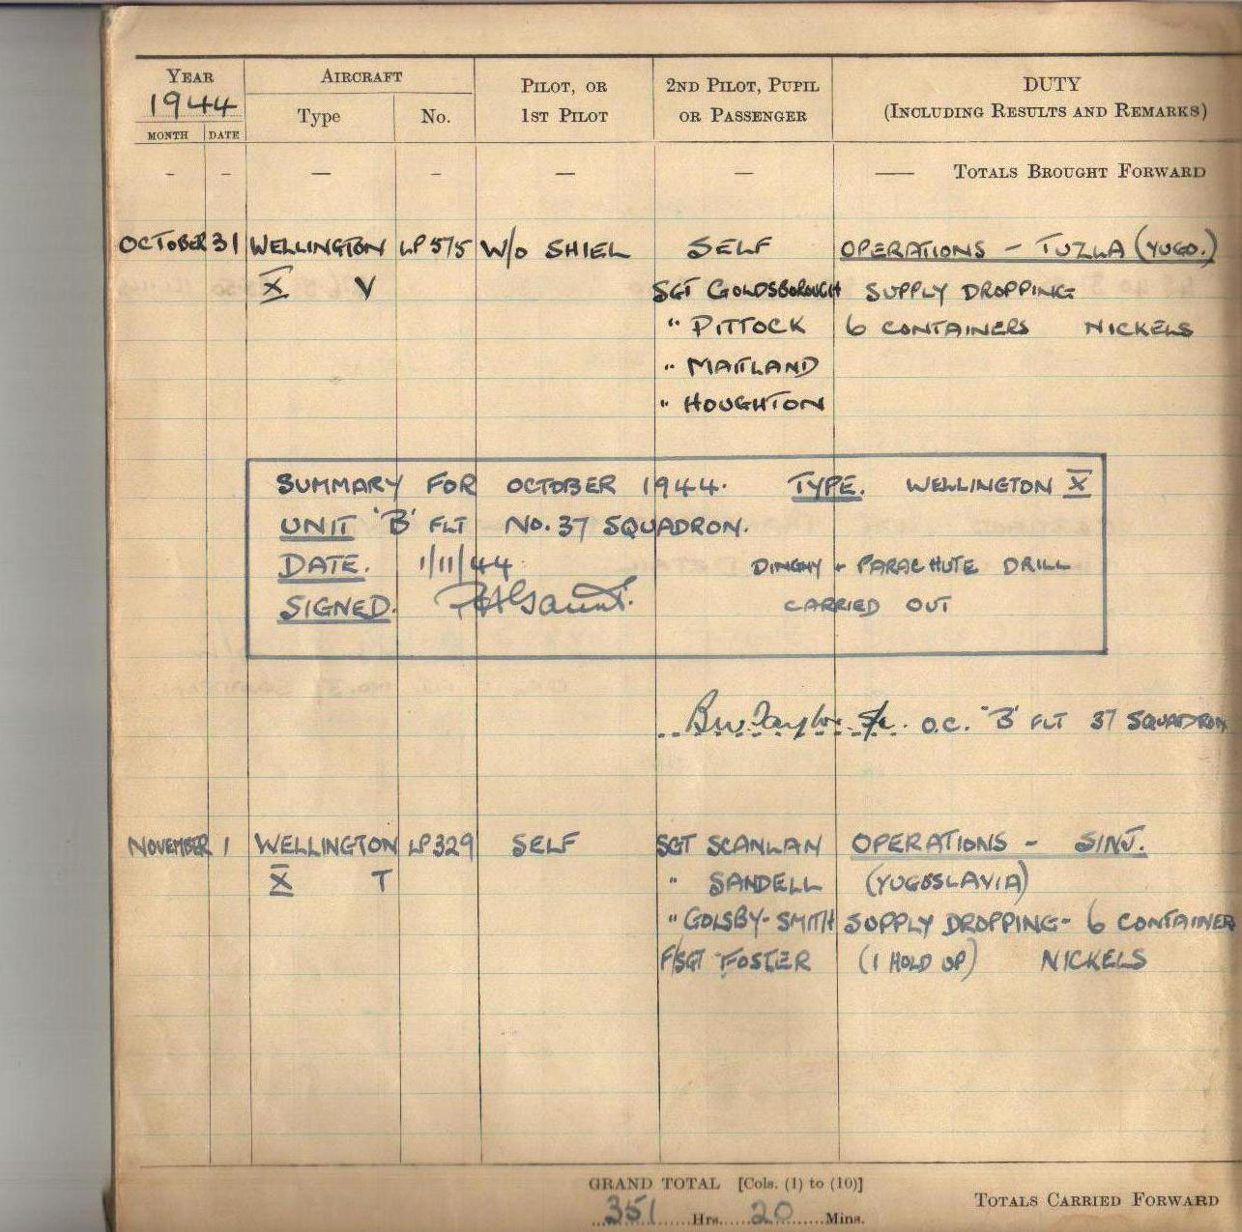

Slide 67
Supply drop Christmas Day 1944.
All the crews safely returned for their Christmas dinners.
The cross, marked on the ground by the Partisans was the target for the supply drop.

Slide 68
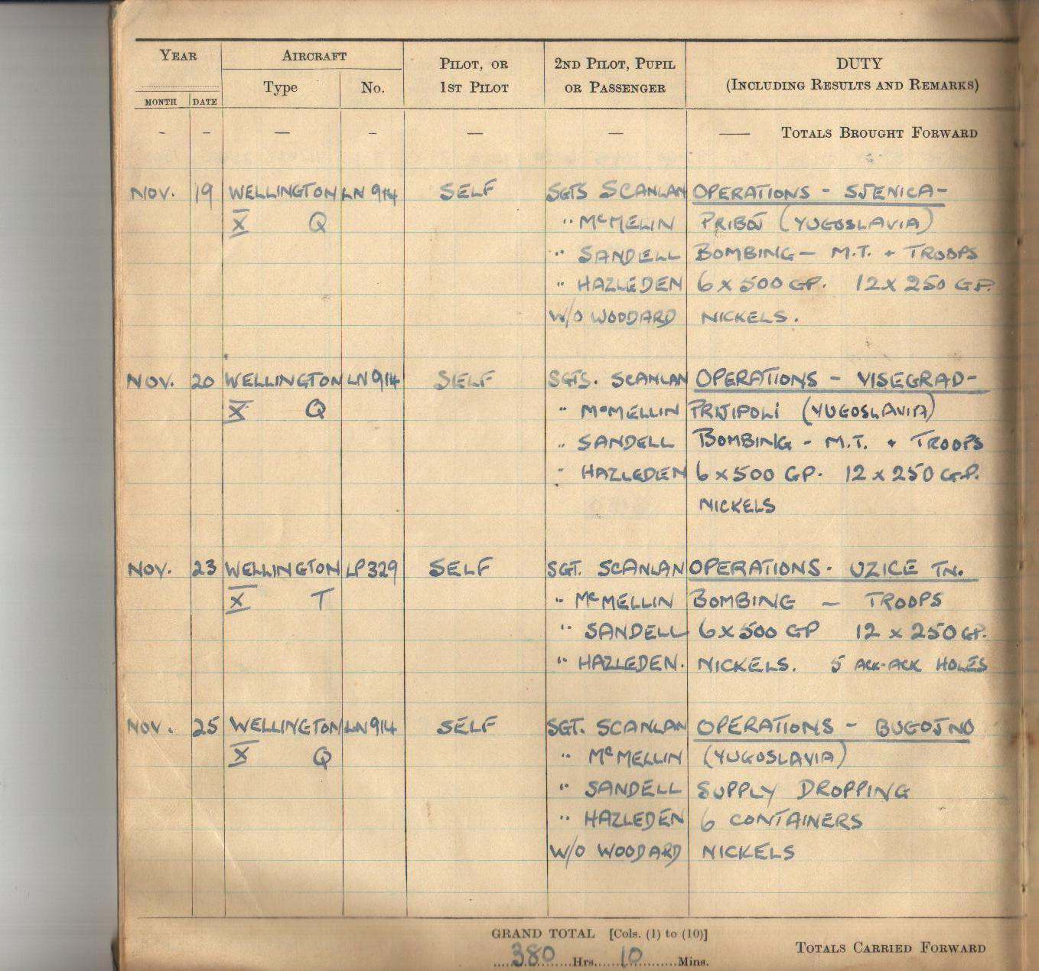

Slide 69
Containers dropping in Slovenia, 1945.
Photos courtesy of the Museum of Contemporary History, Ljubljana.

Slide 70
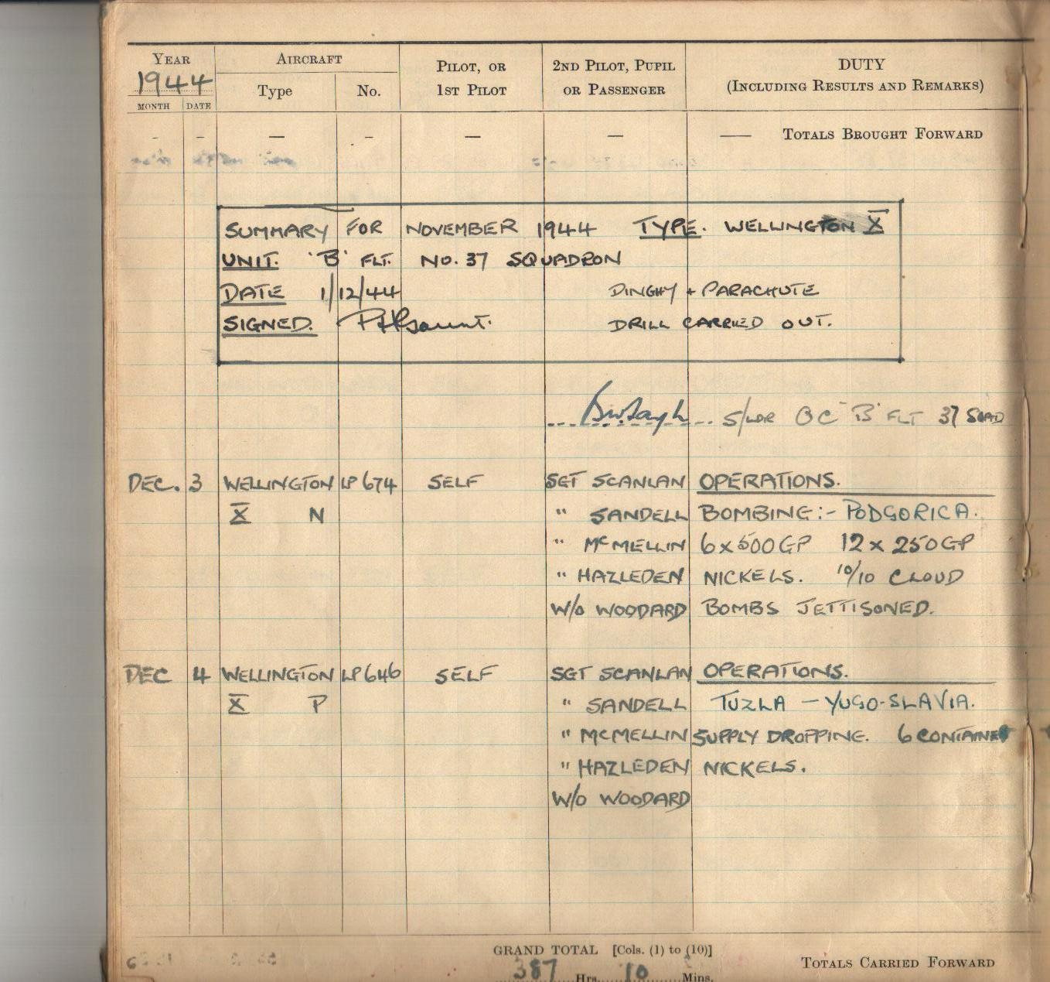

Slide 71
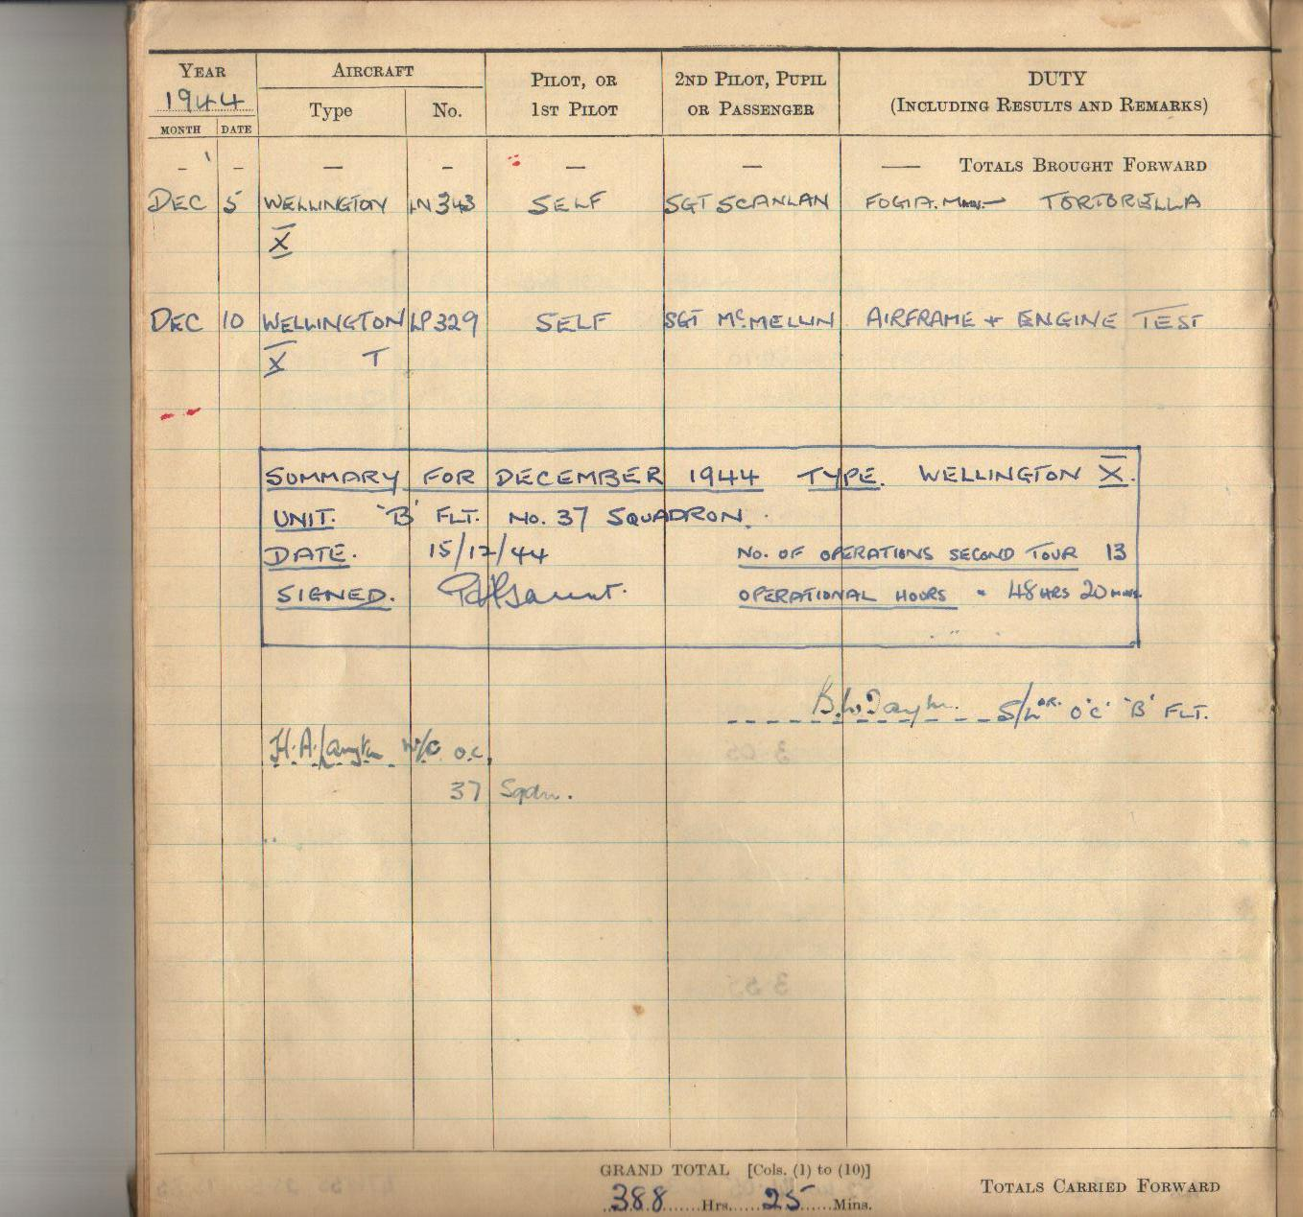

Slide 72
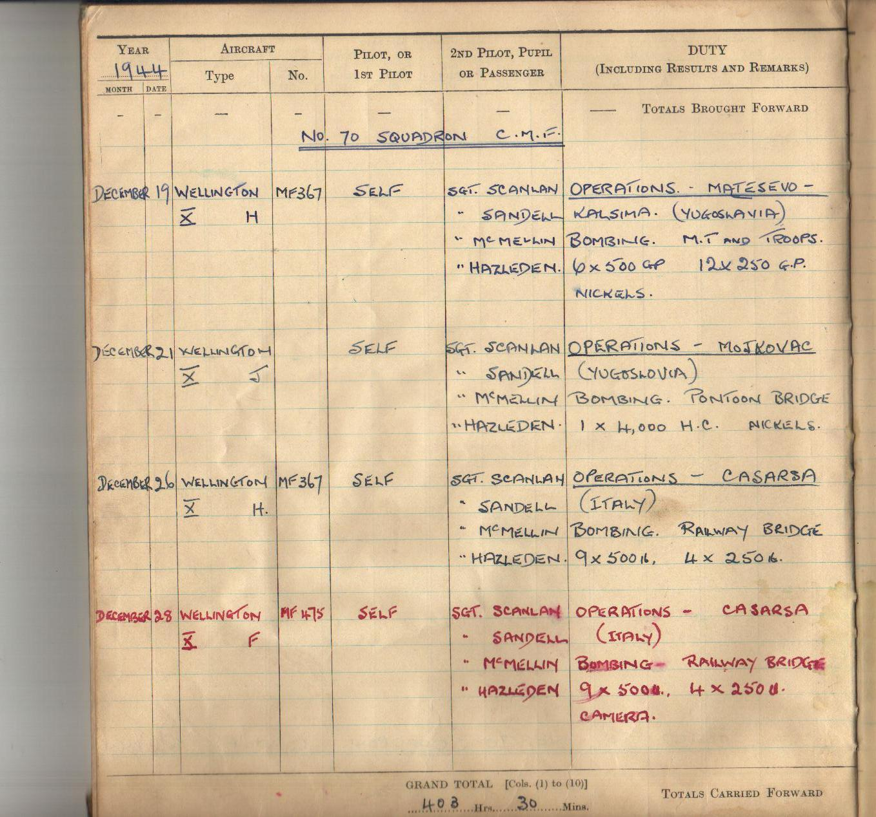

Slide 73
The Sorrento
coast, & view
from the
Minerva
Hotel, 1944,
where most
crews spent
some leave.

Slide 74
Supply drop, Circhina, January 18th,1945.
Drop zone
Shirts being made from parachutes,
Paka, NE Slovenie, July 1944.
Photo courtesy of the Museum of Contemporary History, Ljubljana.

Slide 75
The crest of 37 Squadron

Slide 76
Wellington Mk. 10 bomber waiting for a B17 (flying fortress) to land at Tortorella, Italy 1945

Slide 77
Supply drops, Flotsam area, February 2nd, 3rd & 7th, 1944.
Photos courtesy Norman Moseley.

Slide 78
Bombing Pola (Pula), February 21st, 1945.
Photos courtesy Doug Skinner.
Bombing Pola (Pula) naval dockyards, March 3rd, 1945.

Slide 79
Bombing Fiume (Rieka) docks, February 15th, 1945.
Target photo: Triest, February 17th, 1945.
Photo courtesy Alan Isaac.

Slide 80
The crest of 70 Squadron
The motto USQUAM
translates to “anywhere”

Slide 81
Bombing bridges at Mojkovac on the 21st December 1944.
Photo courtesy Alan Isaac.

Slide 82
Bombing Fiume torpedo factory (Rijeka), February 16th, 1945. Note the Wellington at low level, top right.
Trieste harbour, 1945: all ships sunk or damaged

Slide 83
Bombing Rogatica, November 23rd, 1944.
Bombs away: Rogatica, Yugoslavia, November 1944.

Slide 84
Crash Landing at Gerovo due to fuselage icing

Slide 85
Telegram received by Tubby’s wife.
Text from this telegram received by my Mother Florence via Wigston Post Office on the 11th January 1944
------------------------1st Telegram Sheet------------------
Priority CC. Mrs P. Gaunt 79 Kingston Ave, Wigston.
from Air Ministry 73 Oxford St. W1 PC 65511/145
regret to inform you that your husband W/O PH
Gaunt 755625 is reported missing as the result of
air operations on 9th Jan. Enquiries are being made
through the International Red Cross Committee and any
------------------------2nd Telegram Sheet------------------
further information received will be communicated
to you immediately. Should news of him reach you
from any other source please advise this dept.
Letter follows shortly
0902 A

Slide 86
Tubby’s Wellington crash lands in a dramatic flurry of snow.

Slide 87
Letter written by Maurice (Tubby’s brother) on behalf of Mrs Gaunt, asking for any further information regarding her ‘missing’ husband.

Slide 88
Franja Turk, the English-speaking
villager who helped downed Allied airmen evade capture by the Germans.
Partisan HQ and
British Mission at Scrad.

Slide 89
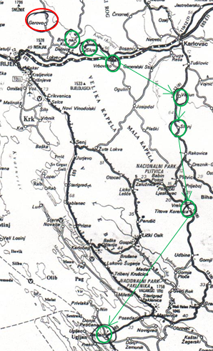
NW Croatia, showing crash landing site & route of repatriation.

Slide 90
A sketch by Geordie Hazelden of conditions at Slunj, February 1945. Tubby is sitting below the bunk where Americans play cards, Scats Sandell lies on the top bunk.

Slide 91
American Liberator Crew (of 10) of which only 4 survived a crash in Croatia, they joined Tubby Slunj.

Slide 92
One means of repatriation was the Douglas (DC-3) Dakota.
Between January and October 1944, 1,152 airmen were airlifted out of Yugoslavia.
Of the above, 795 with Partisan assistance and 356 with help from the Chetnicks.
Partisans in Slovene territory rescued 303 American and 383 British; airmen. These 686 were repatriated by land and sea routes.

Slide 93
Tubby’s crashed Wellington, photograph was taken on the 14th January 1945. Photo courtesy Edi Selhaus.

Slide 94
Tubby’s crashed Wellington, photograph was taken on the 14th January 1945. Photo courtesy Edi Selhaus.

Slide 95
Tubby’s crashed Wellington, photograph was taken on the 14th January 1945. Photo courtesy Edi Selhaus.

Slide 96
Sabotage: railway
engines derailed by
Partisans.
American airmen with Partisans at Kotjansko (Eastern area of Slovenia), 1944.
Photo courtesy of the Museum of Contemporary History, Ljubljana.

Slide 97
Partisans burning railway sleepers and destroying 200metres of track at a time
Partisans using radios supplied by the Allies.
Bridge destroyed
by a joint British/
Partisan mission.

Slide 98
Joint British and Partisan funeral
Party.

Slide 99
All Allied airmen were
treated with equal respect.

Slide 100
A Partisan, winter, patrol.
A column of
Partisans moving
through deep
snow.

Slide 101
Partisans moving in springtime.
Partisans of the 43 Istrian
Division approaching Cabar
(from the direction of Parg
Gorski-Kotar).

Slide 103
HMS COLOMBO
Moored outside Zadar harbour and was used as a staging post for all airmen prior to their transport back to Italy.

Slide 104
HMS Wilton
“Tubby” and crews transport to Bari Italy, after first night on cruiser HMS Colombo

Slide 105
Picture of Tito (leader of the Partisans) and his close aids taken on the 8th January 1945

Slide 106
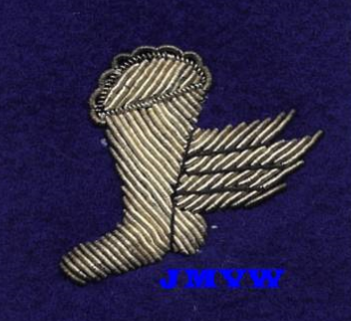
John (aged 16)
Arthur
November 1945, all three serving Gaunt brothers safely back from the war and joining their other two brothers, Peter, the ‘Bevin Boy’, who took the photograph.
Tubby proudly wears his coveted
‘Winged Boot’ insignia, which
was awarded to all airmen that
walked through enemy territory to their freedom.
Tubby
Maurice

Slide 107
Just arrived: Gerovo, Croatia in 1996, Mathew Zgajnar, Denise (my Wife) and I.

Slide 108
The Museum of Contemporary History, Ljubljana, Slovenia, 1996.
Monika Kokalj Kocevar (museum curator), who made everything
possible, on our first
visit to Slovenia & Croatia,
1996.
Researching inside the Museum in 1996;
from left: Monika Kokalj Kocevar, Mathew Zgajnar, Josephine Spalovec, Edi Selhaus (who took the photo’s of my fathers crash landed Wellington bomber and myself.

Slide 109
Bogden Turk,
veteran Partisan
from Cabar.
Bogden Turk and Vinko Janez (who witnessed the crash landing when he was 10 years old),
Pictured outside Vinko’s house in Gerovo.

Slide 110
Typical mountainous views around Gerovo.

Slide 111
The crash landing site, pictured in 1996. From left: the myself, my wife (Denise), Vinko Janez, Monica Kokalj Kocevar and Bogden Turk.
The my late friend,
Miljenko (Mile) Malnar
points out the exact
crash landing site.

Slide 112
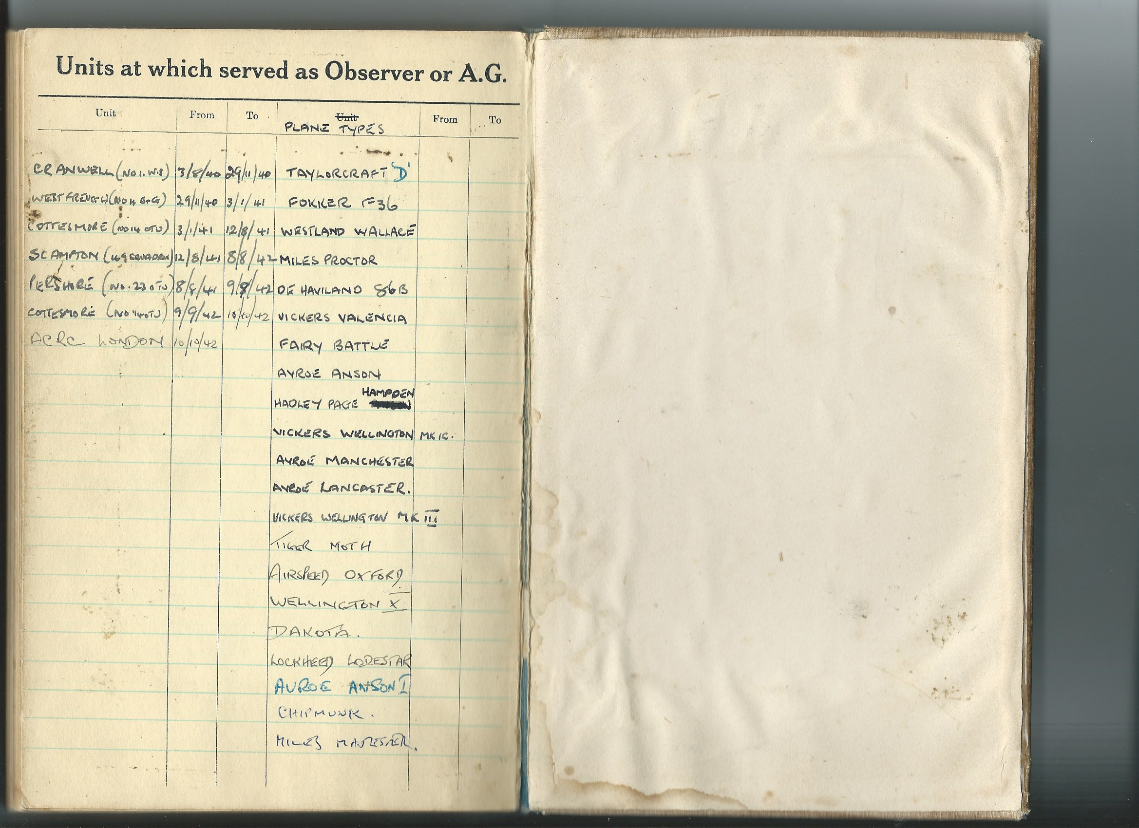
A full list from ‘Tubby’s Logbook of the aircraft he flew in or piloted

Slide 113
My Early Memories
A Tiger Moth flown by my Father ‘Tubby’ at Desford, on the 11th June 1950 during his time in the RAF reserves.

Slide 114
RAF Desford Christmas party: my sister, Ann in the white dress, myself immediately above her left shoulder, and my elder sister, Christina, immediately to the left of Santa’s sack.

Slide 115
With Many Thanks to my Brother, Terry Gaunt, for Producing this Presentation

